Slide 1
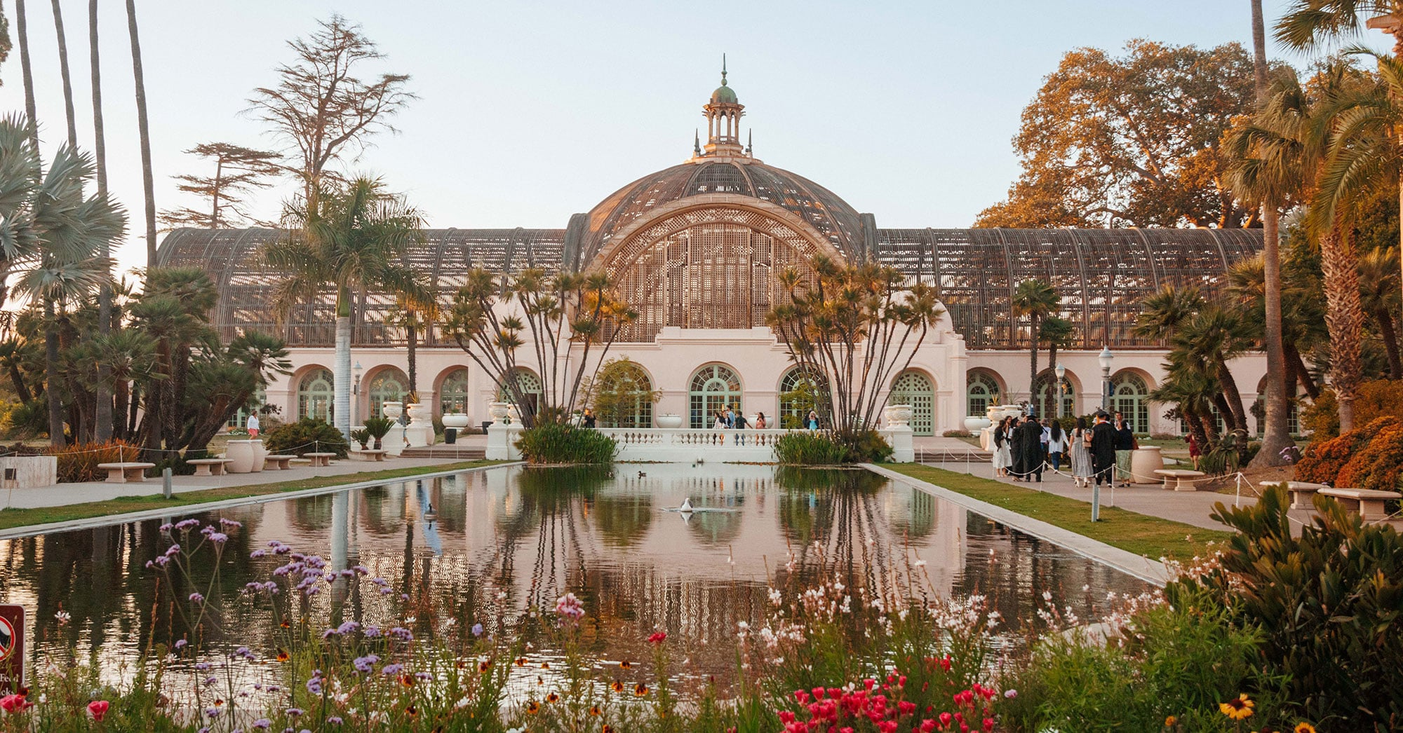
FUTURE OF BALBOA PARK
A shared
calendar.
A stronger
visitor brand.
Global lessons, event coordination
and a quantified business case
Discussion draft / 23 October 2026
Notes:
Prepared for discussion with BCCA, Forever Balboa Park, City stakeholders and cultural institutions. Recommendations are proposals, not adopted policy. Photographs show real places and historical programming, not proposed Balboa Park events. Cover photo sourced from Forever Balboa Park’s rental page.
Sources checked 6 October 2026:
Photo: https://foreverbalboapark.org/wp-content/uploads/2026/03/opt-fbp-botanicabuilding-121-nosign.jpg

Slide 2
INTERVIEW FINDINGS
Fragmented authority creates shared consequences
The park needs a
shared business vision
Institutions, the City and park organizations make decisions with different mandates.
Events share the same access routes, public spaces and visitor experience.
The calendar is a first practical service within a broader governance and funding agreement.
Interview synthesis: Blackson p. 2, Sichel pp. 2–3, project meeting 13 August pp. 1–2
02
Notes:
Stakeholder perceptions, not an audited governance diagnosis. Howard Blackson describes overlapping authority. Chris Sichel asks for a unified strategy. August project discussion explicitly frames the work as a shared business vision complementing the physical master plan. No claim of unanimous institutional agreement.
Local PDFs: Howard Blackson - Interview.pdf pp.2–3; Interview Chris Sichel(1).pdf pp.2–3; 12383d65dfa-44b9-4471-a3cd-12f64a2bb6c4_August_13_2026_441_PM.pdf pp.1–2.
Sources checked 6 October 2026:

Slide 3
INTERVIEW FINDINGS
Shared events can create value across institutions
A positive pattern
A recurring risk
The Fleet interview describes ESRI events buying space across institutions and activating shared outdoor areas.
The same interview describes large outdoor events obstructing parking and entrances, reducing museum attendance.
Success means value for the park and its neighbors
Attendance alone cannot show whether an event benefits the institutions around it.
Interview evidence: Fleet / Steve, 17 August 2026, pp. 2–3. Outcomes are reported experiences, not audited results.
03
Notes:
Source: 1e91de1b-6b86-47bc-88e9-e01a4a0ece26_Meeting_Last_Monday_1100_PM.pdf pp.2–3. Fleet describes ESRI as positive and Earth Day/December Nights as examples of access and revenue impacts. Avoid extrapolating one institution’s experience into quantified park-wide financial losses.
Sources checked 6 October 2026:

Slide 4
INTERVIEW FINDINGS
Simpler permitting starts with a clear front door
One submission.
Visible next steps.
What the service can do
Explain the route, collect a common brief, coordinate affected neighbors and track decisions.
Stakeholders favor simpler access to outdoor spaces. The Fleet describes a separate, lengthy process once an event crosses its building boundary.
What remains with the City
Applicable permits, public-space conditions and safety decisions. A calendar entry never substitutes for authorization.
Interview synthesis: Fleet p. 3, Blackson pp. 2–3, Casey Smith pp. 1–2 and 7–9
04
Notes:
Reported permitting friction appears in Fleet and Howard Blackson interviews. These are perceptions, not a comprehensive statement of current permit law. Casey suggests expanding FBP support. Current public rental routes vary by venue. Proposal: an administrative front door, with no assumption that municipal powers have transferred.
Sources checked 6 October 2026:
https://balboapark.org/balboa-park-private-events/
https://foreverbalboapark.org/special-event-rentals/

Slide 5
INTERVIEW FINDINGS
Revenue-neutral is a minimum design principle
An event should not leave
a neighboring institution
worse off
Protect public access and normal visitation. Agree on setup, traffic and mitigation before committing to shared-space use.
Measure net impact, including extra staffing and displaced activity. Use agreed baselines and a dispute process.
Fleet p. 3 and Stepner p. 3. Proposed principle, not a guaranteed financial outcome.
05
Notes:
Fleet interview explicitly states revenue-neutral at minimum for nearby institutions. Stepner raises equitable revenue sharing, adjacent institution impacts, and protection of peak public-use days. Revenue-neutral is a proposed event-level planning target rather than an automatic reimbursement promise. Sources: Fleet interview pp.2–3 and Michael Stepner - Interview.pdf p.3.
Sources checked 6 October 2026:

Slide 6
INTERVIEW FINDINGS
Forever Balboa Park is a credible potential keeper
Support already exists
The mandate still needs agreement
Casey Smith sees FBP as a possible go-to partner for outdoor events. Chris Sichel favors a more unified park-wide role.
July discussions also record institutional concern about outdoor activations. Participation must include real influence over impacts.
A service institutions help govern
FBP coordinates. Institutions retain their events and customer relationships. The City retains public authority.
Sources: Casey Smith pp. 7–9, Sichel pp. 2–3, 15 July project meeting pp. 2–3
06
Notes:
The documents contain differing perspectives: Sichel describes a well-received shared-space model, while the July 15 meeting reports institutional opposition to an activation. These are not reconciled as a verified consensus. The keeper role is proposed and depends on a written mandate, capacity and institutional trust. Interview-reported 90/10 revenue split is not treated as a verified universal rule.
Sources checked 6 October 2026:

Slide 7
PROJECT CONTEXT
Organizations and venues have different roles
Public authority
Coordination and representation
City of San Diego owns public park assets and retains applicable permit and public-space decisions.
Forever Balboa Park is a potential keeper. Balboa Park Cultural Partnership represents shared institutional interests.
Project and funding partners
Independent institutions
BCCA convenes discussion. DDX / Sebastian Gier supports research and design. Foundations may fund agreed work.
Fleet Science Center and The Nat are relevant starting points. Each institution retains its venues, events and customers.
Source: supplied project briefing. Proposed participation does not imply a confirmed partnership.
07
Notes:
Source: user-supplied Projektbriefing: Future of Balboa Park, received 23 October 2026. Roles reflect the project discussion, not a new legal mandate.

Slide 8
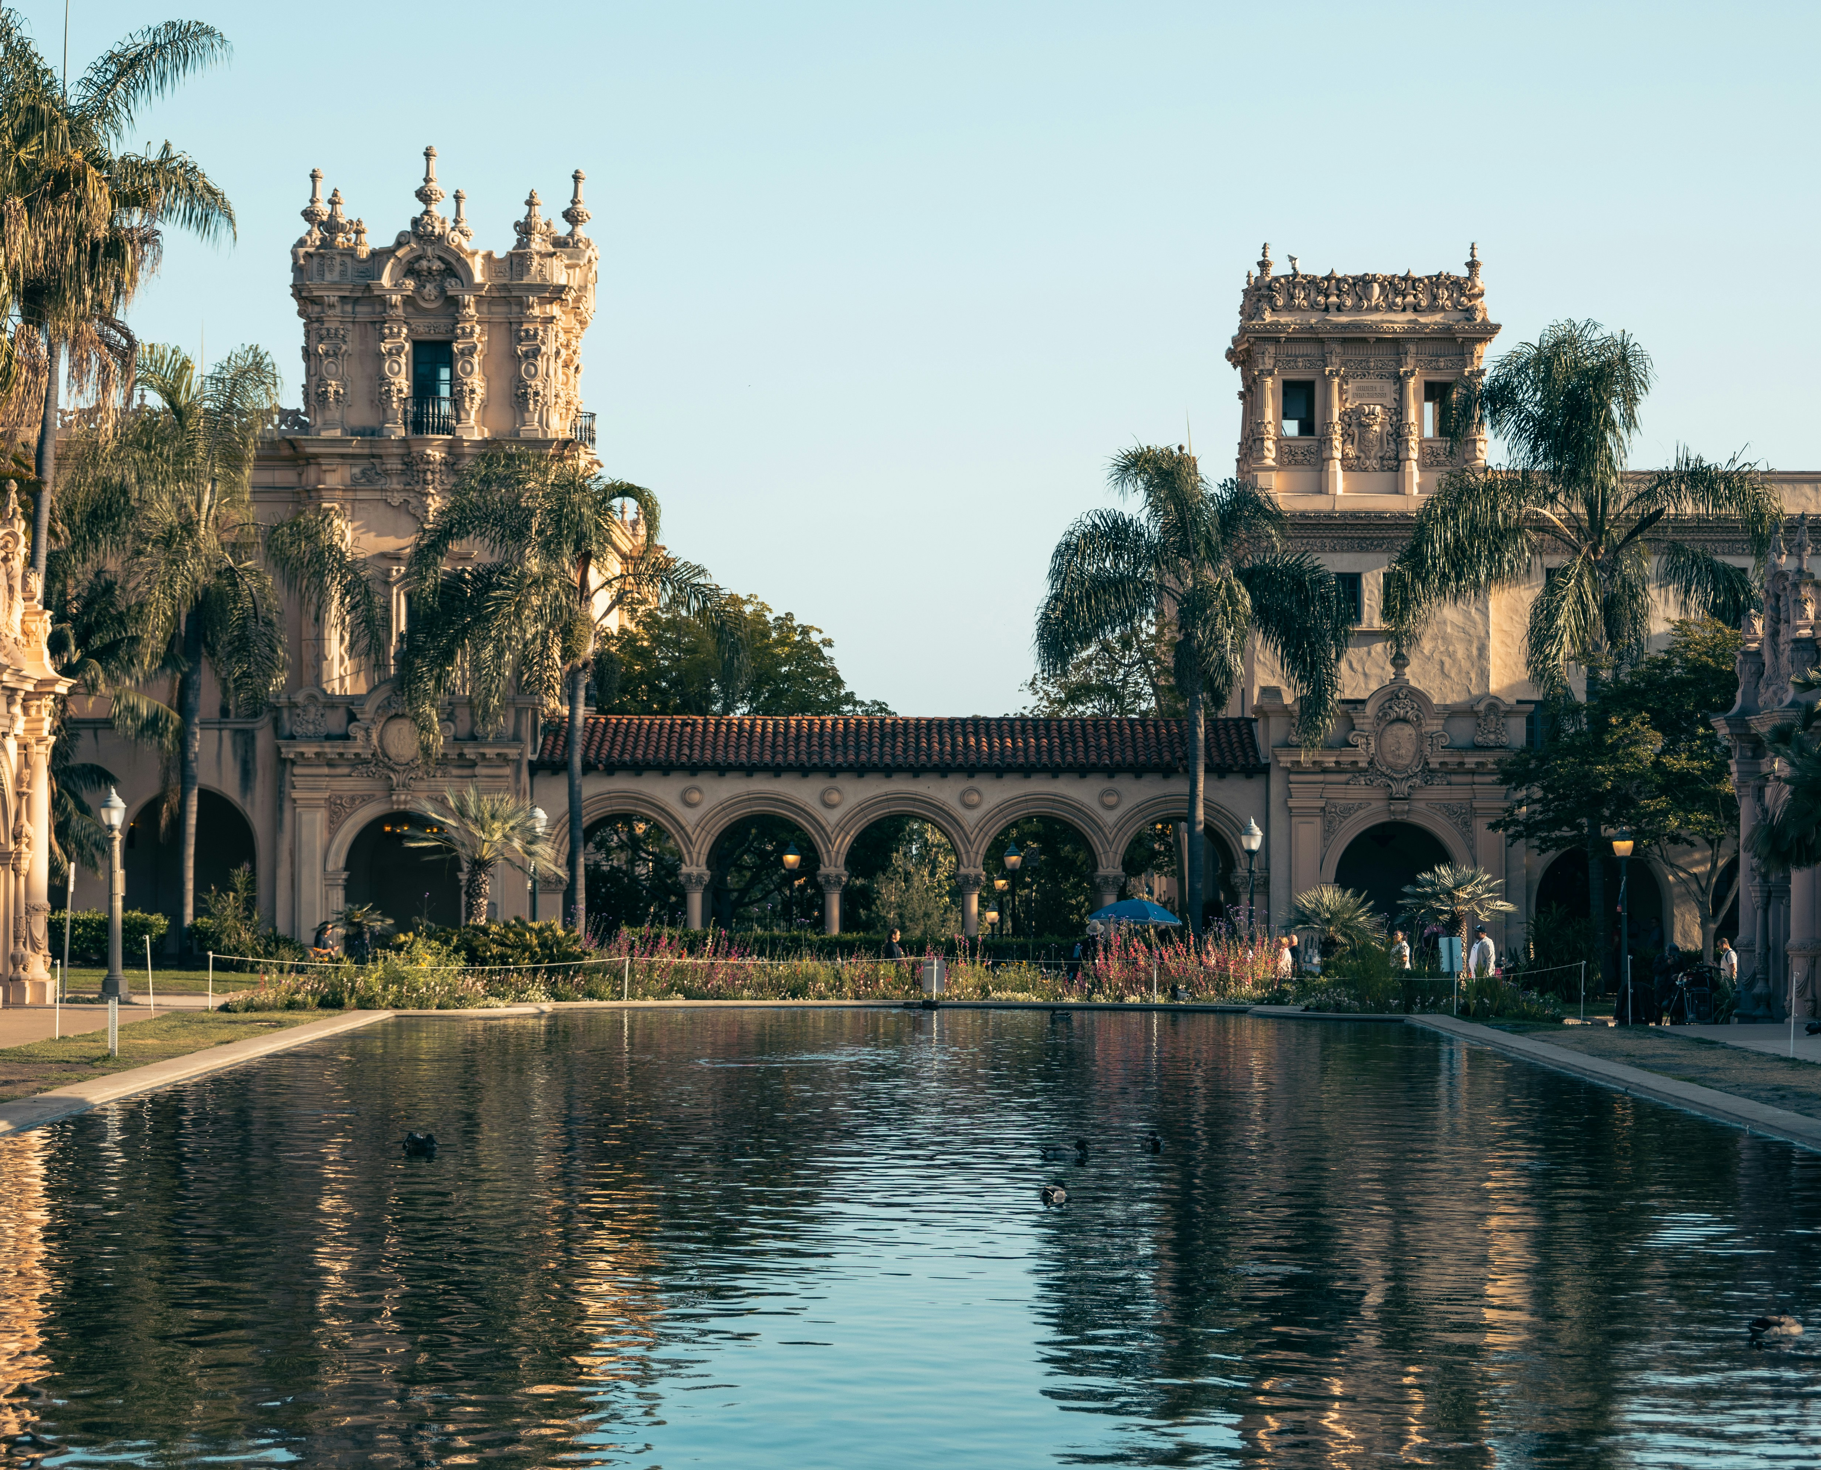
SHARED EVENT OPPORTUNITY
Fleet Science Center, The Nat and the space between
Indoor programming
An organizer could combine activities at Fleet Science Center and the San Diego Natural History Museum (The Nat).
Shared outdoor component
The Bea Evenson Fountain area could connect the experience, subject to City review and agreement with affected institutions.
Separate venue contracts and outdoor permissions remain essential
Project proposal. Validate outdoor footprint, permissions and terms. Photograph shows an illustrative Balboa Park setting.
08
Notes:
Source: supplied project briefing and Fleet / Steve interview as cited in the existing deck. ESRI is a reported positive example, not audited commercial evidence. Photo supplied by user: Vincent Y USA, sgIko2AuMgE, Unsplash. The photo shows a Balboa Park setting, not a mapped event footprint.

Slide 9
GLOBAL BENCHMARKS
Six core comparisons address the operating model
Place | Model | Most useful lesson
Lincoln Park, Chicago, USA | Public park, conservancy and independent institutions | Defined site responsibilities and retained venue control
Lincoln Center, New York, USA | Multi-institution arts campus | Shared service costs and campus collaboration
MuseumsQuartier, Vienna, Austria | Publicly owned cultural district operator | Shared courtyards, tenants and event services
South Bank, London, UK | Business Improvement District | Member mandate and funded common services
Fed Square, Melbourne, Australia | Civic square and cultural campus operator | Event delivery, safety and commercial packaging
Forest Park, St. Louis, USA | City–nonprofit conservancy partnership | Explicit responsibilities with distributed bookings
Verified facts = primary public sources. Interview report = project testimony. Proposal / inference = our analysis.
09
Notes:
Selection is comparative and purposive, not a ranking. No benchmark exactly replicates Balboa Park’s scale, ownership, institutions and transport conditions. Public calendars do not by themselves prove shared internal scheduling. Software, cadence and mandatory data-sharing rules are marked unknown when not discoverable.
Sources checked 6 October 2026:
https://www.lincolncenter.org/i/about
https://www.mqw.at/en/the-mq/organization/
https://southbankbid.co.uk/about-us
https://fedsquare.com/about
https://www.forestparkforever.org/news/2024/forest-park-forever-city-of-st-louis-renew-public-private-partnership-to-sustain-forest-park-for-decades

Slide 10

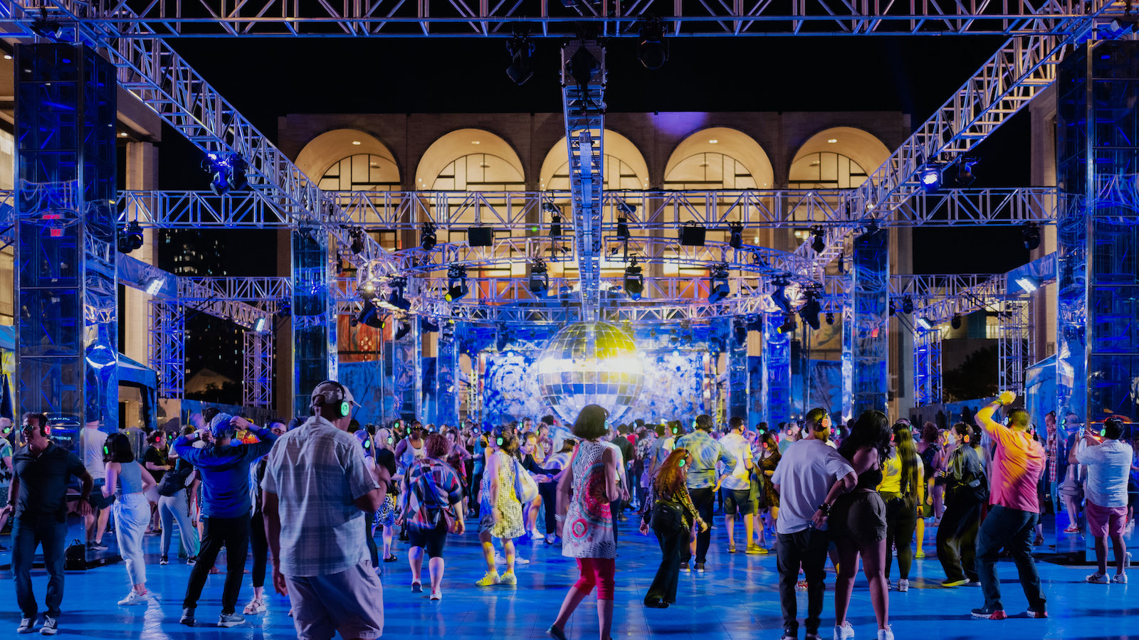
NEW YORK, UNITED STATES
CENTRAL CALENDAR MANAGEMENT: NOT VERIFIED
Lincoln Center: a campus service organization
Verified model
LCPA works alongside 10 fellow resident arts organizations and provides common facilities services.
Programming / inferred incentive
Summer for the City activates indoor and outdoor venues. Shared fundraising and visibility offer reasons to collaborate.
Balboa lesson: fund the work of coordination
Sources: LCPA About, 2025 audited accounts, Summer for the City. Photo: Lincoln Center website. Lesson is inference.
10
Notes:
Verified: LCPA is a nonprofit, presents complementary programs and has 10 fellow resident arts organizations. FY2025 audited financial statements note 2(l), PDF p.11, describe charging resident arts organizations for their spaces and a share of common-area services. Public Summer for the City calendar lists venue-specific programs. Campus Fund provides unrestricted support to 10 organizations. Incentive interpretation: shared fundraising, marketing and services can support participation, but participation outcomes were not independently measured.
Sources checked 6 October 2026:
https://www.lincolncenter.org/i/about
https://res.cloudinary.com/lcpa-fountain/image/upload/niwonxm9iflxomsrlslo
https://www.lincolncenter.org/series/summer-for-the-city/v/calendar
https://www.lincolncenter.org/support/
Photo: https://images.lincolncenter.org/image/upload/v1656598913/nelzlf1l6s4ludoptfze.jpg
Flag image: https://flagcdn.com/w160/us.png
Calendar status added 23 October 2026. Not verified means the reviewed evidence does not establish a shared internal operational calendar. It does not establish absence. Public listings and event services alone do not establish central calendar management.

Slide 11
BENCHMARK EVIDENCE
CENTRAL CALENDAR MANAGEMENT: NOT VERIFIED
Lincoln Center: what is confirmed, and what is not
Verified in primary sources | Reported in this project, still to verify
Resident organizations pay for facility services and common-area costs. | Weekly coordination meetings and a shared internal calendar.
Funding includes donations, grants, investment income, hall revenue and facility services. | Practitioners pay for the coordinating entity’s service, while calendar access is free.
A public calendar filters events by venue, format and access needs. | Internal software, data ownership, escalation rules and event priority policy.
Implication for Balboa Park
The service-cost principle is supported. The exact meeting and calendar arrangement requires an operator interview.
Source of reported model: Sophia Eichner’s 29 September email in the referenced project conversation.
11
Notes:
FY2025 consolidated accounts pp.4–5 and note 2(l) on PDF p.11 verify the funding categories and allocation of common-area services. They do not establish a calendar fee policy. Project email reports Katie’s visit to Lincoln Center and the weekly meeting/fee account. Recommended operator interview questions: who contributes data, what is compulsory, who resolves competing holds, how common-area costs are allocated, which system supports coordination, and how emergency changes propagate. Do not cite the public calendar as evidence of internal integration.
Sources checked 6 October 2026:
https://res.cloudinary.com/lcpa-fountain/image/upload/niwonxm9iflxomsrlslo
https://www.lincolncenter.org/series/summer-for-the-city/v/calendar
Flag image: https://flagcdn.com/w160/us.png
Calendar status added 23 October 2026. Not verified means the reviewed evidence does not establish a shared internal operational calendar. It does not establish absence. Public listings and event services alone do not establish central calendar management.

Slide 12

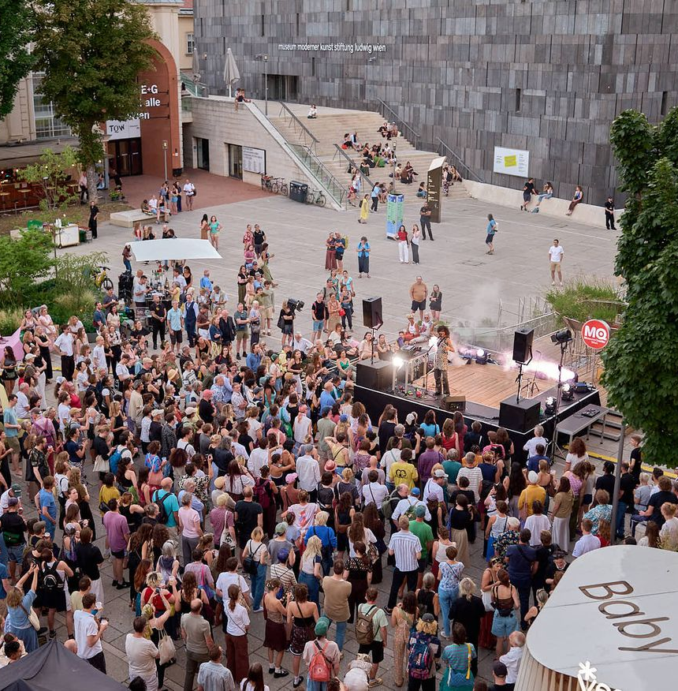
VIENNA, AUSTRIA
CENTRAL CALENDAR MANAGEMENT: NOT VERIFIED
MuseumsQuartier: shared space with a clear operator
Governance and operations
Calendar and programming
MQ E+B manages the site. Ownership: Austria 75%, Vienna 25%. A rental team coordinates event space and services.
Public event listings sit alongside venue inquiries. MQ Summer Stage includes concerts, literature and outdoor film.
Funding and incentives
Lesson for Balboa
Federal operating support and own revenues, including rentals. Inferred benefit: shared marketing and event packages.
Package indoor and outdoor experiences with site rules. Internal booking software and meeting cadence remain unverified.
Primary sources: MQ organization, rentals, Summer Stage, Austrian funding portal. Photo: MQ / Thomas Meyer.
12
Notes:
Verified: operator ownership and remit include property management, programs, rentals and destination marketing. The current organization page lists 61 cultural institutions, including 9 permanent arts/cultural institutions, a useful scale comparison rather than 61 equivalent tenants. MQ site rules require prior authorization for relevant activities and vehicle access. Rental team and Green Meeting support are published. Federal operating-cost reimbursement is net of own income under an annual financial plan. Digital evidence: public event calendar and venue inquiry. No verified internal calendaring platform, universal submission rule or meeting cadence. Inferred incentives and transfer lesson are our analysis.
Sources checked 6 October 2026:
https://www.mqw.at/en/the-mq/organization/
https://www.mqw.at/en/rentals/
https://www.mqw.at/en/program/mq-summer-stage/
https://transparenzportal.gv.at/tdb/tp/leistung/1065671.html
https://service.mqw.at/wp-content/uploads/2024/10/MQ-Haus-und-Veranstaltungsordnung-Areal.pdf
Photo: https://www.mqw.at/media/images/B_2026.59cb8224.fill-1168x876.format-jpeg.jpegquality-80.jpg
Flag image: https://flagcdn.com/w160/at.png
Calendar status added 23 October 2026. Not verified means the reviewed evidence does not establish a shared internal operational calendar. It does not establish absence. Public listings and event services alone do not establish central calendar management.

Slide 13

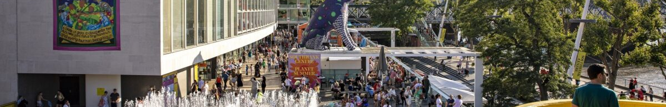
LONDON, UNITED KINGDOM
CENTRAL CALENDAR MANAGEMENT: NOT VERIFIED
South Bank: institutions fund a common district service
Governance and funding
Coordination and discovery
Inferred benefit and lesson
A business board governs the BID. SBEG delivers services. A voted levy funds shared work, with charitable relief.
Place-management partnerships support the public realm. South Bank London aggregates listings such as film festivals, theatre and exhibitions.
Marketing, security and insight make the common service tangible. Balboa can adopt a member compact. A UK levy is not directly transferable.
Public listings are verified. A common internal event calendar and its vendor are not. Photo: South Bank London / Naomi (site credit).
13
Notes:
Verified: BID company board, delivery by South Bank Employers’ Group, mandatory levy after a successful ballot, charitable relief, five-year term 2024–2029. Local operators retain their programming. The BID plan describes a Place Management Group and coordination of public-realm services. Public destination website has date/category/free filters and venue discovery. Events include BFI London Film Festival listings, theatre and exhibitions, not claimed to be produced by the BID. Funding also benefits from landowner contributions and London Eye Section 106 arrangements through SBEG. Inference: tangible service benefits can sustain institutional participation. Neither a unified internal scheduling tool nor routine calendar meeting cadence is established.
Sources checked 6 October 2026:
https://southbankbid.co.uk/about-us
https://southbank.london/whats-on
https://southbankbid.co.uk/services/business-support/strategic-partnership-working
https://southbankbid.co.uk/assets/publications/south-bank-bid-third-term-business-plan-%281%29.pdf
Photo: https://southbank.london/content/images/native-transforms/_1200x630_crop_center-center_82_none/southbank-centre-riverside-terrace-in-summer-by-Naomi.jpg?mtime=1692957336
Flag image: https://flagcdn.com/w160/gb.png
Calendar status added 23 October 2026. Not verified means the reviewed evidence does not establish a shared internal operational calendar. It does not establish absence. Public listings and event services alone do not establish central calendar management.

Slide 14

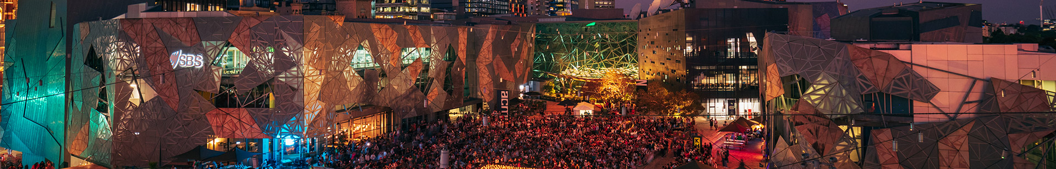
MELBOURNE, AUSTRALIA
CENTRAL CALENDAR MANAGEMENT: NOT VERIFIED
Fed Square: event coordination becomes a service
Governance and delivery
Programming and digital
Business model and lesson
MAP Co operates the square, home to ACMI, Koorie Heritage Trust and NGV Australia. Venue managers offer end-to-end event support.
Open Air and RESET mix civic culture with public activation. Public listings, venue tours and Linksafe contractor induction support delivery.
Rentals, tenancy rents, parking and sponsorship support the model. Packages connect events with dining and museum tours. Inferred incentive: new venue business.
Internal calendar vendor and allocation rules are undisclosed. Photo: Fed Square, Candlelight Concert / Damien Raggatt.
14
Notes:
Verified in official pages: MAP Co operation, cultural institutions, event-management service, venue inventory, parking arrangements, and cross-selling of restaurants and institution tours. Site induction explicitly references Linksafe and the ComplyMe portal, which is a safety/compliance system, not proof of calendar software. Revenue categories evidenced in FY2022–23 annual report: venue hire/event services, carpark, tenancy rents, sponsorship and commercial activations. Latest FY2024–25 report reviewed for continuing commercial partnerships, but no claim that older financial amounts are current. Free Open Air and RESET programming shown in 2026 media releases. Inference: incremental visitor spending, venue leads and service support are participation benefits. Public operator’s authority is stronger than FBP’s proposed role.
Sources checked 6 October 2026:
https://fedsquare.com/about
https://fedsquare.com/plan-your-event
https://fedsquare.com/site-induction
https://www.parliament.vic.gov.au/globalassets/tabled-paper-documents/tabled-paper-7669/melbourne_arts_precinct_corporation_annual_report_2022-23.pdf
https://cdn.artsprecinct.melbourne/assets/Melbourne-Arts-Precinct-Corporation-Annual-Report-2024-25.pdf
https://fedsquare.com/media-centre
Photo: https://fedsquare.wpenginepowered.com/wp-content/uploads/2024/04/candlelight-concert-2023-evening-crowd-in-square.jpg
Flag image: https://flagcdn.com/w160/au.png
Calendar status added 23 October 2026. Not verified means the reviewed evidence does not establish a shared internal operational calendar. It does not establish absence. Public listings and event services alone do not establish central calendar management.

Slide 15
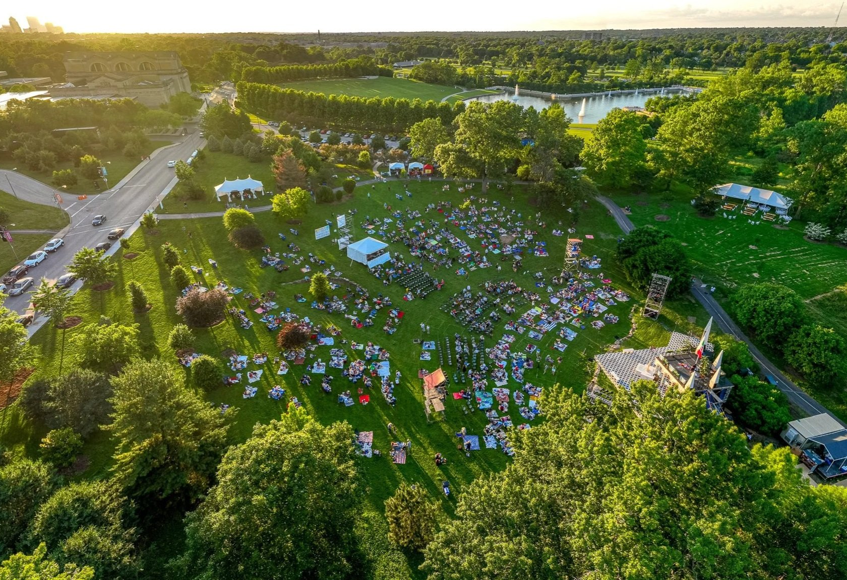
ST. LOUIS, UNITED STATES
CENTRAL CALENDAR MANAGEMENT: NOT VERIFIED
Forest Park: partnership does not require one booking owner
Governance and funding
The City and Forest Park Forever renewed a maintenance cooperation agreement in 2024. Public funds and private giving support park care.
Events and coordination
Outdoor permits route to the City, venue inquiries to institutions. Inferred benefit: shared visibility and stewardship with booking control retained.
Balboa lesson: specify each partner’s responsibilities
Examples include Art Hill programming and the Great Forest Park Balloon Race. Photo: Forest Park Forever website.
15
Notes:
Verified: 2024 Maintenance Cooperation Agreement defines day-to-day care responsibilities and collaborative decisions with dedicated public/private funding. It is a maintenance model, not evidence that the conservancy owns an integrated event calendar. Rentals page directs institution venue requests to each institution and outdoor gatherings to the City Parks Department. Public calendar and navigation resources support discovery. Internal coordination software, recurring event-planning cadence and data obligations are unknown. Great Forest Park Balloon Race verified in City September 2026 event information. Art Hill Film Series appears in conservancy public listings. Inference: partner services and shared stewardship benefit institutions, but booking control remains distributed.
Sources checked 6 October 2026:
https://www.forestparkforever.org/news/2024/forest-park-forever-city-of-st-louis-renew-public-private-partnership-to-sustain-forest-park-for-decades
https://www.forestparkforever.org/rentals
https://www.forestparkforever.org/calendar
https://www.stlouis-mo.gov/services/topic.cfm?id=163&name=arts-and-entertainment-events
https://www.forestparkforever.org/
Photo: https://images.squarespace-cdn.com/content/v1/5233160ae4b08346f3be204b/68e5dcca-de28-4447-80a6-7e512f12b05e/20220603-003+%281%29.jpg
Flag image: https://flagcdn.com/w160/us.png
Calendar status added 23 October 2026. Not verified means the reviewed evidence does not establish a shared internal operational calendar. It does not establish absence. Public listings and event services alone do not establish central calendar management.

Slide 16
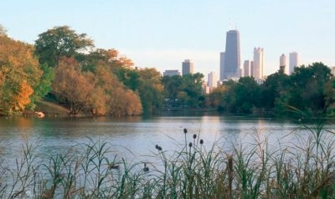
CHICAGO, UNITED STATES
CENTRAL CALENDAR MANAGEMENT: NOT VERIFIED
Lincoln Park: public space with independent institutions
A comparable physical setting
About 1,200 acres with a zoo, two museums, conservatory, public landscapes and recreation.
Defined responsibilities
Chicago Park District oversees the park. The Conservancy has a formal partnership and specific site roles. Institutions retain separate operations.
Balboa lesson: specify what the coordinating entity can actually manage
Verified structure. Transferability is our analysis. Photo: Lincoln Park Conservancy, North Pond.
16
Notes:
Checked 7 October 2026. Lincoln Park, Chicago, is distinct from Lincoln Center, New York. Strong structural comparison: a public park containing separately operated cultural institutions. Park District is a separate public authority, not the City parks department. The Conservancy manages specific sites and programs under agreement, not every institution. Main institutional examples: Lincoln Park Zoo, Chicago History Museum, Peggy Notebaert Nature Museum and Lincoln Park Conservatory. Incentive inference: institutions benefit from cared-for surroundings and visitor services while retaining control. Public authority form and smaller museum concentration limit equivalence.
Sources checked 6 October 2026:
https://www.lincolnparkconservancy.org/about-us/
https://www.chicagoparkdistrict.com/parks-facilities/lincoln-abraham-park
https://www.lincolnparkconservancy.org/about-us/about-lincoln-park/
Photo: https://www.lincolnparkconservancy.org/wp-content/uploads/elementor/thumbs/northpondhome-qu1yuvfai37rbkguuc31dm2h8scd1x0mqzcaivnr20.jpg
Flag image: https://flagcdn.com/w160/us.png
Calendar status added 23 October 2026. Not verified means the reviewed evidence does not establish a shared internal operational calendar. It does not establish absence. Public listings and event services alone do not establish central calendar management.

Slide 17
CHICAGO EVENT AND DIGITAL MODEL
CENTRAL CALENDAR MANAGEMENT: NOT VERIFIED
Lincoln Park combines delegated services with separate booking
Layer | Verified practice | Lesson for Balboa Park
Conservancy | Manages Lily Pool event permits and Conservatory timed entry. Public calendar and newsletter. | FBP could take on named services through an explicit agreement.
Park District | 2026 online event application, conditional permit, document review and final approval. | Show booking status and the responsible authority. Submission is not approval.
Visitor tools | Conservatory reservations link to Zeffy. Athletic-field requests use ActiveNet plus a request form. | Several tools can coexist. A shared internal conflict calendar remains unverified.
Institution programming | ZooLights has sponsored, ticketed evenings and selected free nights. Museums and zoo run their own programming. | Retain institution ownership while coordinating access and promotion.
Balboa lesson: delegate defined services and keep venue control local
Unknown: cross-institution meeting cadence, internal calendar, data-sharing rules and automated conflict detection.
17
Notes:
Checked 7 October 2026. Conservancy About Us expressly lists Lily Pool permits, Conservatory ticketing and escalation of community concerns to Park District. Reservations page links Zeffy. Park District park listing names ActiveNet for field requests. Current permits page documents online 2026 application and conditional/final approvals. No public evidence establishes a shared backend across institutions. ZooLights 2026 official press release verifies sponsors and paid/free evenings.
Sources checked 6 October 2026:
https://www.lincolnparkconservancy.org/about-us/
https://www.chicagoparkdistrict.com/permits-rentals-101
https://www.lincolnparkconservancy.org/conservatory-reservations/
https://www.chicagoparkdistrict.com/parks-facilities/lincoln-abraham-park
https://www.lincolnparkconservancy.org/calendar/
https://www.lpzoo.org/pressroom/zoolights-2/
Flag image: https://flagcdn.com/w160/us.png
Calendar status added 23 October 2026. Not verified means the reviewed evidence does not establish a shared internal operational calendar. It does not establish absence. Public listings and event services alone do not establish central calendar management.

Slide 18
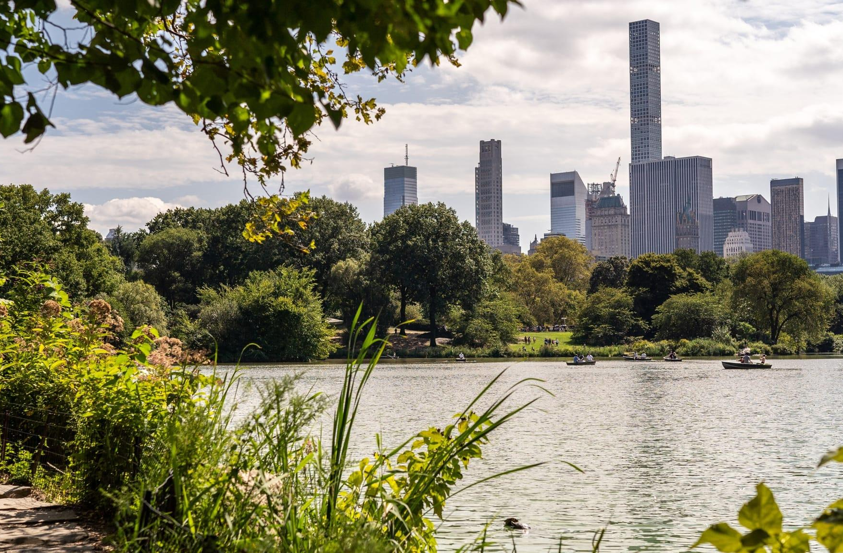
NEW YORK, UNITED STATES
CENTRAL CALENDAR MANAGEMENT: YES (2016)
Central Park: a documented internal event calendar
A shared operational record
The Conservancy’s 2016 guide describes an internal weekly calendar distributed across the organization, alongside weekly joint operations meetings.
City and conservancy roles
NYC Parks confirms dates and locations. Conservancy staff assess impacts and monitor setup through removal.
Balboa lesson: connect the calendar to permit status and field operations
2016 operating guide, pp. 6–9. Current process and software require confirmation. Photo: Central Park Conservancy.
18
Notes:
https://assets.centralparknyc.org/pdfs/institute/CPC-Institute-Special-Events-FAQ.pdf Printed pp. 6–9: joint weekly meetings, staff lists, internal weekly calendar. Reviewed 23 October 2026. Historical evidence only. https://www.centralparknyc.org/our-story Photo from supplied benchmark deck, credited there to CPC Our Story, The Lake, 2019.

Slide 19
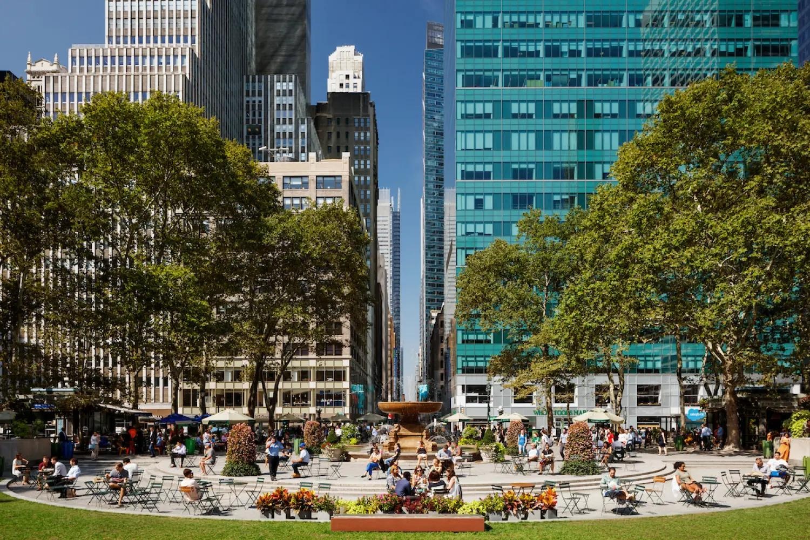
NEW YORK, UNITED STATES
CENTRAL CALENDAR MANAGEMENT: NOT VERIFIED
Bryant Park: programming supports park operations
An integrated management organization
Bryant Park Corporation operates the park under an agreement with the City. Dedicated staff manage programming, events and partnerships.
Income and participation
Sponsorship, concessions and special events complement a broad free program. The model requires a staffed operating business.
Balboa lesson: link programming income to the cost of running the park
Management and funding model documented. Shared internal calendar not verified. Photo: Colin Miller / Bryant Park.
19
Notes:
https://bryantpark.org/about-us/management-and-board reviewed 23 October 2026. https://bryantpark.org/assets/uploads/documents/general/FY24_BryantParkCorporationandBryantParkManagementCorporation_FS.pdf Funding categories carried from supplied benchmark deck, with no new financial totals asserted. Photo: supplied deck, credited to Colin Miller, official homepage.

Slide 20
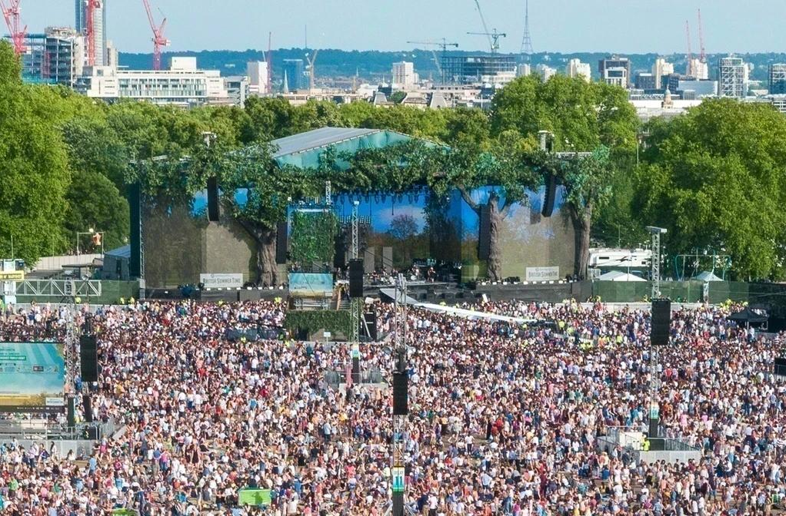
LONDON, UNITED KINGDOM
CENTRAL CALENDAR MANAGEMENT: NOT VERIFIED
The Royal Parks: event income serves stewardship
A dedicated event review process
The Events team reviews proposals against public benefit and landscape constraints. Major opportunities use procurement.
Capacity and reinvestment
Event income contributes to park care. Current guidance says several parks are at event capacity. Application review determines fees.
Balboa lesson: establish site limits and reinvestment rules before selling
Official event guidance reviewed 23 October 2026. Internal calendar not verified. Photo: The Royal Parks.
20
Notes:
https://www.royalparks.org.uk/commercial-licences/events/hold-large-event reviewed 23 October 2026. Capacity notice names Hyde Park, The Regent’s Park, St James’s Park and The Green Park. No calendar software or shared internal system verified. Photo: supplied benchmark deck, official BST festival image.

Slide 21
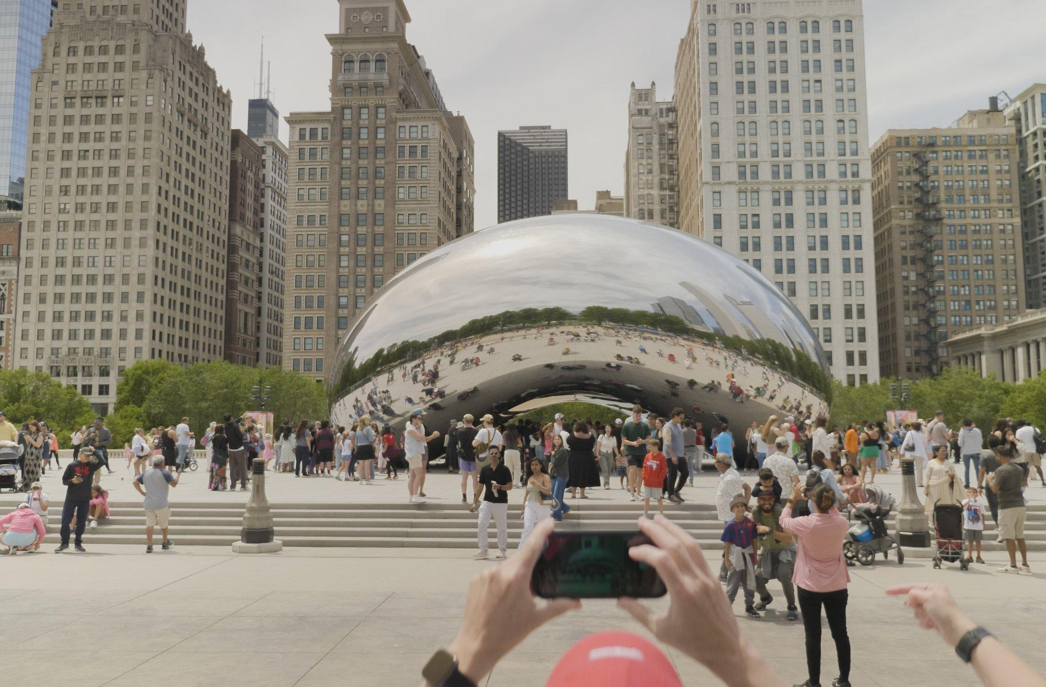
CHICAGO, UNITED STATES
CENTRAL CALENDAR MANAGEMENT: NOT VERIFIED
Millennium Park: philanthropy adds civic capacity
City leadership and foundation support
The Foundation works with Chicago’s Department of Cultural Affairs and Special Events to support stewardship and cultural experiences.
Funding and visitor programming
Philanthropy supports capital investment, maintenance and artistic innovation. City channels provide public event information.
Balboa lesson: fund agreed services while retaining public authority
Partnership evidence from the supplied benchmark deck. Shared internal calendar not verified. Photo: Millennium Park Foundation.
21
Notes:
https://www.millenniumparkfoundation.org/ Source and photograph from Balboa-Park-Benchmarks.pptx, slide 7, research dated 7 October 2026. This establishes a partnership, not an internal scheduling platform. Transfer lesson is analysis.

Slide 22
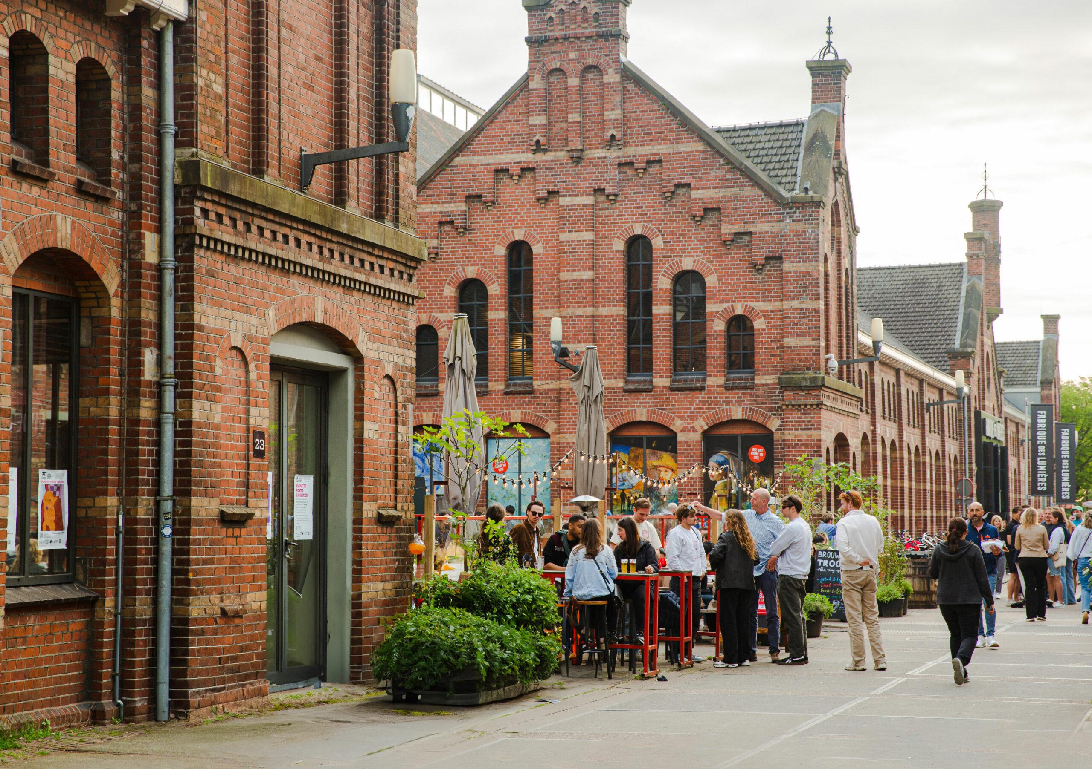
AMSTERDAM, NETHERLANDS
CENTRAL CALENDAR MANAGEMENT: NOT VERIFIED
Westergas: one identity, distinct site responsibilities
Buildings and public space
Westergas curates the cultural buildings. Stadsdeel West manages public space. A shared district identity can connect the visitor experience.
A mixed destination
Cultural tenants, event venues and hospitality contribute to the destination. Programming includes art fairs and performances.
Balboa lesson: coordinate places without assuming common ownership
Reported in the supplied benchmark deck. Shared internal calendar not verified. Photo: Westergas.
22
Notes:
https://westergas.nl/en/mission-vision/?noredirect=en_US Source from supplied benchmark deck, slide 8, reviewed there 7 October 2026. The page could not be independently re-fetched on 23 October 2026. Preserve attribution to the supplied research. Photo: https://westergas.nl/en/wp-content/uploads/sites/2/2025/08/Troost2.jpg

Slide 23
BENCHMARK FINANCIAL EVIDENCE
Commercial income requires an operating business
Operator / period | Reported income | Meaning for Balboa Park
Lincoln Center / FY2025 | US$50.77m halls and related income (general operations) US$35.41m facilities services | Venues and shared services can generate substantial income, with substantial delivery costs.
Fed Square / FY2024–25 | A$4.32m events A$0.54m sponsorship | An active sales and venue operation supports commercial income. These figures are revenue, before costs.
South Bank BID / 2026–27 plan | £1.58m planned total income £1.50m from existing and new-development levies | A UK levy funds common services. Balboa would need its own agreed funding mechanism.
The calendar supports a staffed sales and service operation.
Original currencies. Actuals and plans are distinct. No conversion or direct revenue-per-visitor comparison.
23
Notes:
Primary financial evidence. LCPA FY2025 audited accounts printed p.4: concert halls and related revenue US$50.772m general operating versus US$64.872m consolidated total, which includes US$14.1m redevelopment deferred-revenue recognition. Facilities services total US$35.413m. Do not treat either as surplus. MAP Co FY2024–25 report printed pp.158–159 and note2.1 pp.196–197: events A$4,316,172, sponsorship A$539,878, tenancy rents A$19,565,002, parking A$5,011,464. Not an FBP entitlement to institutional rent or parking. South Bank five-year plan printed pp.30–31: 2026–27 total income £1,576,792, levy £1,440,000 plus new developments £55,125. These are plans, not audited outturns. Lessons are interpretation.
Sources checked 6 October 2026:
https://res.cloudinary.com/lcpa-fountain/image/upload/niwonxm9iflxomsrlslo
https://cdn.artsprecinct.melbourne/assets/Melbourne-Arts-Precinct-Corporation-Annual-Report-2024-25.pdf
https://southbankbid.co.uk/assets/publications/south-bank-bid-third-term-business-plan-%281%29.pdf

Slide 24
BENCHMARK SCALE AND COMMERCIAL EVIDENCE
Large audiences still need a diversified funding model
MuseumsQuartier, Vienna
Forest Park, St. Louis
61 cultural institutions and over 5 million visitors in current operator materials.
The federal portal lists €3.963m budgeted operating support. The portal does not specify a fiscal year for that amount.
15.5 million annual visits in the 2024 partnership announcement.
The US$100m Imagine the Glade campaign had secured over 60% at its February 2025 announcement. This is a capital campaign.
Fed Square reports +16% booked events after its B2B strategy
It also reports five multi-venue bookings in 2024–25, a concrete example of institutions selling together.
Operator-reported scale and outcomes. Campaign funds and recurring operating income serve different purposes.
24
Notes:
MQ operator press page states 61 institutions and over five million visitors without an explicit measurement year or methodology. Do not interpret as distinct people or compare directly with other counting methods. Austrian transparency portal displays €3.963m budgeted volume, checked6October2026, fiscal period unspecified. Forest Park2024 renewal announcement reports15.5m annual visits. February13,2025 Glade announcement reports US$100m campaign target, over60% committed. MAPCo2024–25 printedpp158–159 attributes131% more website traffic and16% more booked events to the B2B strategy and reports five multi-venue bookings. These are management-reported outcomes, not a controlled causal evaluation.
Sources checked 6 October 2026:
https://www.mqw.at/en/mq-press-page/general-information/
https://transparenzportal.gv.at/tdb/tp/leistung/1065671.html
https://www.forestparkforever.org/news/2024/forest-park-forever-city-of-st-louis-renew-public-private-partnership-to-sustain-forest-park-for-decades
https://www.forestparkforever.org/news/steinberg-at-the-glade
https://cdn.artsprecinct.melbourne/assets/Melbourne-Arts-Precinct-Corporation-Annual-Report-2024-25.pdf

Slide 25
GOVERNANCE BENCHMARKING
Lincoln Park and Forest Park are the closest park comparisons
Place and country | Public authority and institutions | Fit with Balboa Park
Lincoln Park · Chicago, USA | Park District + conservancy with defined site roles + separately operated zoo and museums | Close fit in scale and institutional mix. Public authority is a park district.
Forest Park · St. Louis, USA | Municipal park + separate conservancy + museums, zoo and other institutions | Close fit. City and institutions retain booking responsibilities.
Lincoln Center · New York, USA | Arts campus with resident organizations and a common-service nonprofit | Useful for shared services. Much smaller and less park-like.
MuseumsQuartier · Vienna, Austria | Operator owned 75% by Austria and 25% by Vienna, with cultural institutions | City participation and shared spaces. More centralized property authority.
Fed Square · Melbourne, Australia | State-established operator with cultural tenants and a civic square | Relevant event business. Different authority and compact footprint.
South Bank · London, UK | BID, local authorities, landowners and independently run cultural venues | Relevant coalition. A district rather than one municipal park.
Comparative interpretation based on operator sources. None duplicates Balboa’s full ownership, scale and institutional structure.
25
Notes:
Benchmark update checked 7 October 2026. Forest Park Forever is separate from the Zoo Museum District and partners with the City. Its public rentals information retains distributed booking. MQ ownership from FY2025 report. Fed Square operated by MAP Co. South Bank BID is distinct from Southbank Centre. Fit is analytical, not an externally validated ranking.
Sources checked 6 October 2026:
https://www.forestparkforever.org/about
https://www.forestparkforever.org/news/2024/forest-park-forever-city-of-st-louis-renew-public-private-partnership-to-sustain-forest-park-for-decades
https://www.forestparkforever.org/rentals
https://www.lincolncenter.org/i/about
https://www.mqw.at/documents/42/MQ_Jahresbericht-2025-versand.pdf
https://fedsquare.com/about
https://southbankbid.co.uk/about-us
https://www.lincolnparkconservancy.org/about-us/
https://www.chicagoparkdistrict.com/parks-facilities/lincoln-abraham-park

Slide 26
SOFTWARE AND WORKFLOW BENCHMARKS
Comparable calendar and event tools already exist
Example | Documented use | What transfers to Balboa
Carnegie Museums Pittsburgh, USA | Momentus Elite across 4 museums at 3 locations, over 350 events annually and 25 team members | Master calendar, lead forms, multiple holds, task allocation and separate museum/caterer financials.
Royal Agricultural Society of NSW Sydney, Australia | Momentus portals for performer schedules, contracts and parking allocations at the Royal Easter Show | Role-specific views, self-service submissions and operational dashboards.
Saint Louis Art Museum Forest Park, USA | Momentus publishes a named customer testimonial from the museum | Evidence that an institution in the closest park comparator uses venue software. No proof of park-wide integration.
The remaining challenge is shared rules across independent organizations
Vendor-published customer evidence. Adoption does not establish independently measured ROI or a full Balboa-like deployment.
26
Notes:
Benchmark update checked 7 October 2026. Carnegie case study pp.1–4 states four museums on three sites, 350+ events, 25 users, master calendar, lead forms and separate contracting with catering. It describes early adoption, so do not claim proven ROI. The PDF has an inconsistent job-title caption on p.3, avoided here. RAS case study describes 2021 event context, not current park-wide SOPA software. Saint Louis Art Museum quote establishes a customer relationship only. These are adjacent workflow precedents, not identical governance.
Sources checked 6 October 2026:
https://infohub.gomomentus.com/hubfs/Case%20Studies/Carnegie%20Museums%20Customer%20Story.pdf
https://infohub.gomomentus.com/hubfs/Case%20Studies/The%20Royal%20Agricultural%20Society%20of%20NSW%20Case%20Study.pdf
https://gomomentus.com/customer-stories

Slide 27
CALENDAR CAPABILITY COMPARISON
Public discovery and internal operations need separate evidence
Benchmark | Visitor-facing discovery | Internal coordination evidence
Lincoln Park, Chicago, USA | Conservancy calendar and Zeffy reservations. Separate zoo programming. | Delegated site permits and District application verified. Shared internal calendar unverified.
Lincoln Center, USA | Public calendar with venue and access filters | Shared facilities documented. Weekly calendar practice is project testimony, pending operator verification.
MuseumsQuartier, Austria | Program listings and venue inquiry | Event rental team and site rules verified. Internal calendar vendor unverified.
South Bank, UK | District “What’s on” listings | Place-management partnerships verified. Shared internal scheduling tool unverified.
Fed Square, Australia | Events, venue options and event-service inquiry | Event-management services and Linksafe induction verified. Linksafe is not a scheduling system.
Forest Park, USA | Public calendar, interactive map and rentals directory | City / institution routing verified. No verified park-wide internal platform.
Unknown means not established in the reviewed sources, not that the capability is absent.
27
Notes:
Benchmark update checked 7 October 2026. Capability audit distinguishes public interfaces, documented services and internal platforms. No public calendar is used as proof of capacity modeling, conflict prediction, institution lanes or cross-entity permissions. These requirements need operator interviews and product demonstrations before procurement.
Sources checked 6 October 2026:
https://www.lincolnparkconservancy.org/about-us/
https://www.chicagoparkdistrict.com/permits-rentals-101
https://www.lincolnparkconservancy.org/conservatory-reservations/
https://www.lincolnparkconservancy.org/calendar/
https://www.lincolncenter.org/series/summer-for-the-city/v/calendar
https://res.cloudinary.com/lcpa-fountain/image/upload/niwonxm9iflxomsrlslo
https://www.mqw.at/en/rentals/
https://service.mqw.at/wp-content/uploads/2024/10/MQ-Haus-und-Veranstaltungsordnung-Areal.pdf
https://southbank.london/whats-on
https://southbankbid.co.uk/services/business-support/strategic-partnership-working
https://fedsquare.com/plan-your-event
https://fedsquare.com/site-induction
https://www.forestparkforever.org/calendar
https://www.forestparkforever.org/rentals
https://www.forestparkforever.org/park-navigation

Slide 28
CALENDAR EVIDENCE
Which places have central calendar management?
Place | Central calendar management | Evidence boundary
Central Park, New York | Yes, documented in 2016 | Internal weekly event calendar. Current process unconfirmed.
Lincoln Center, New York | Not verified | Project testimony, not direct operator confirmation.
Lincoln Park, Chicago | Not verified | Separate permits, institution events and visitor tools.
Forest Park, St. Louis | Not verified | Distributed bookings and public calendar.
MuseumsQuartier, Vienna | Not verified | Rental team and public listings.
South Bank, London | Not verified | District listings and place management.
Fed Square, Melbourne | Not verified | Event delivery and induction tools.
Bryant Park, New York | Not verified | Integrated event team, internal calendar undisclosed.
The Royal Parks, London | Not verified | Central event review, internal calendar undisclosed.
Millennium Park, Chicago | Not verified | City programming and foundation partnership.
Westergas, Amsterdam | Not verified | Distinct managers and shared public identity.
Yes = documented internal calendar. No = confirmed absence. Not verified = insufficient evidence, not absence.
28
Notes:
Definition: a shared internal event schedule supporting site operations, not simply a public What’s on page. Central Park: CPC 2016 Managing Special Events FAQ, p. 9, https://assets.centralparknyc.org/pdfs/institute/CPC-Institute-Special-Events-FAQ.pdf. Remaining status assessments follow evidence in each benchmark slide and the source register. None of the reviewed sources establishes confirmed absence, so no park is labeled No. Current practice still requires operator interviews.

Slide 29
LOCAL TECHNOLOGY HISTORY
Balboa Park has its own collaborative-calendar precedent
2009–2012
A 2012 practitioner paper describes a central event feed for the park website, apps, kiosks and media partners.
The design allowed museums to create events independently and share them through the central portal.
BPOC developed shared event publishing with member institutions
First discovery step: inventory today’s feeds, owners and workflows with BPOC
Historical evidence, not a claim that the 2012 Drupal system still runs today. The current site already accepts event submissions.
29
Notes:
Benchmark update checked 7 October 2026. Primary practitioner paper by Maren Dougherty, BPOC, Museums and the Web2012. It describes work begun in2009, collaborative calendar development with Palantir, recurring events, syndicated feeds, central edits and distribution to apps/kiosks/media. Current software lineage and coverage require confirmation. Historical innovation does not establish internal permits, parking pressure or conflict coordination. New proposal should build on or integrate existing assets rather than assume a blank slate.
Sources checked 6 October 2026:
https://www.museumsandtheweb.com/mw2012/papers/save_the_date_producing_calendar_content_for_m.html
https://balboapark.org/contact-us/

Slide 30
BENCHMARK SYNTHESIS
The transferable model combines service and consent
Borrow | Adapt for Balboa Park | Avoid assuming
Lincoln Center’s shared services | A funded coordinator and transparent service costs | A calendar alone creates cooperation
MQ and Fed Square’s event support | One intake route with joint venue packages | FBP already has campus-wide authority
South Bank’s member mandate | Institutions help set priorities and evaluate benefits | A compulsory local levy is ready to use
Lincoln Park and Forest Park agreements | Define FBP’s site services and institution rights | A conservancy automatically controls every venue
Recommended direction: a federated coordination service
Analytical synthesis of the six benchmarks. Transferability depends on Balboa Park’s agreements and operating capacity.
30
Notes:
Inference and recommendation. All comparisons carry limits: Lincoln Center is a compact arts campus, MQ and Fed Square have established site operators, South Bank has UK BID legislation, Forest Park’s verified partnership concerns maintenance, and Lincoln Park delegates specific services under a Park District agreement. Balboa’s service should keep institution authority distributed while making cross-boundary impacts visible.
Sources checked 6 October 2026:
https://res.cloudinary.com/lcpa-fountain/image/upload/niwonxm9iflxomsrlslo
https://www.mqw.at/en/the-mq/organization/
https://fedsquare.com/plan-your-event
https://southbankbid.co.uk/about-us
https://www.forestparkforever.org/news/2024/forest-park-forever-city-of-st-louis-renew-public-private-partnership-to-sustain-forest-park-for-decades
https://www.lincolnparkconservancy.org/about-us/

Slide 31
ADDITIONAL BENCHMARK LESSONS
Coordination needs an operating mandate
Central Park
Bryant Park and The Royal Parks
A weekly internal calendar can support operational decisions and permit checks. A regular review meeting makes the record useful.
Commercial programming needs a funded team, site limits and transparent reinvestment into park care.
Millennium Park
Westergas
A nonprofit can fund agreed capacity alongside City leadership, without taking over every public decision.
One destination identity can connect independently managed buildings and public spaces.
Strategic interpretation of the supplied benchmark deck. These lessons do not establish Balboa authority or revenues.
31
Notes:
Sources: the five additional benchmark slides and Balboa-Park-Benchmarks.pptx, slides 4–9. Analysis for Balboa Park.

Slide 32
RECOMMENDED OPERATING MODEL
A proposed coordination service, hosted by Forever Balboa Park
Institutions retain
control of their events
FBP maintains the
shared operational view
They manage programming, venue contracts, ticketing, customers and approved public content.
A dedicated coordinator checks completeness, convenes affected parties, tracks decisions and supports joint opportunities.
The City participates as both event organizer and public authority
Proposal. Requires a written scope, staff capacity, institutional participation and agreement with the City.
32
Notes:
Suggested scope: begin with the central cultural area and high-impact shared spaces, then expand. FBP’s coordination team should be accountable for the accuracy and timeliness of the shared record, not for unilateral artistic decisions. Its own events must follow the same procedure. Preserve existing venue and City workflows where they work. The service mandate and any permissions for outdoor space must be confirmed before operation.
Sources checked 6 October 2026:

Slide 33
PROPOSED GOVERNANCE
Decision rights remain explicit
Role | Owns | Must contribute
City departments | Permits, public-space decisions and applicable safety authority | City events, roadworks, closures and a named escalation lead
Institutions | Their programs, venues, ticketing and event records | Early notice, attendance estimates and impact review
FBP coordination team | Shared record, meeting agenda and issue tracking | Neutral facilitation, change alerts and decision log
Joint steering group | Service scope, standards, budget and evaluation | Institution, City and FBP representation with community/access input
Event organizer | Delivery plan and agreed mitigation | Setup/teardown, access, vendors and post-event actuals
Proposal. City powers and existing venue rights are not reassigned by the steering group.
33
Notes:
Proposed steering group has balanced representation rather than one vote per event volume. Include Balboa Park Cultural Partnership and other institution representatives, City Parks and relevant operations/permit leads, FBP, and community/accessibility perspectives. BCCA can facilitate the initial agreement and independent evaluation, with no proposed permit authority. Adopt conflict-of-interest recusal when FBP is event producer or salesperson.
Sources checked 6 October 2026:

Slide 34
PROPOSED INCENTIVES
Participation has to save time and protect value
Participant | Benefit | Reciprocal commitment
Institutions | Fewer surprises, easier coordination and qualified shared-event leads | One named owner, early holds and current impact data
City teams | Earlier resource planning and a clearer record of impacts | The same early-notice rules for City-sponsored events
Community organizers | A legible route through requirements and shared spaces | Complete event briefs and agreed public-access measures
FBP | A funded stewardship service and measurable park benefit | Transparent costs, neutral coordination and published service results
Core coordination and standard public listings should be free
Proposal. Optional event services can be priced separately after the pilot demonstrates value.
34
Notes:
Offer calendar access to all pilot contributors without charging for routine data entry or conflict reporting. Incentives depend on reliability, fair access and useful outputs. Avoid exclusive lead allocation, pay-to-prioritize scheduling or forced transfer of customer records. A written City participation commitment is essential because the service cannot deliver completeness through institutional goodwill alone.
Sources checked 6 October 2026:

Slide 35
PROPOSED CADENCE
A regular planning rhythm makes the calendar useful
When | Who | Decision or output
Rolling 12-month horizon | All event owners | Provisional holds, civic dates, closures and likely peaks
Every two weeks, 45 minutes | Institution and City operations leads, FBP chair | Next 90 days: conflicts, mitigations and collaboration opportunities
Weekly during peak periods | Affected operators and event producers | Next 30 days: access routes, staffing, parking and dependencies
Monthly | Public discovery editors | Confirmed public listings, joint campaigns and visitor information
Quarterly | Joint steering group | Service performance, disputes, funding and policy adjustments
Pilot assumptions. Meeting frequency should respond to event load. Written decisions reduce repeat discussion.
35
Notes:
Proposed service targets: new high-impact submissions triaged within two working days, affected institutions asked to respond within five working days, unresolved issues escalated before public commitment. These are coordination targets, not municipal permit-processing promises. Enter known events as early as practicable, including setup/teardown. An event lead reports material changes promptly and uses a phone escalation for urgent safety issues.
Sources checked 6 October 2026:

Slide 36
PROPOSED OPERATING RULES
Conflicts need a fair resolution process
1 Detect and explain
2 Resolve with the neighbors
Flag competing space holds, setup windows, access blockages, sound or parking pressure. Show the affected parties and reason.
FBP proposes alternatives. Organizers agree on timing, footprint, routing or mitigation. Record who accepts the plan.
3 Escalate by decision right
4 Learn from actual impacts
City or venue owner decides within its authority. Service-policy disputes go to the steering group with recusals.
Review attendance, extra costs and complaints. Apply the agreed remedy and improve future thresholds.
Proposed priority criteria: safety and access, existing rights, community value, documented impacts and fair treatment.
36
Notes:
No automatic priority for the largest payer, largest institution or earliest incomplete submission. A provisional calendar hold grants no permit and must have an expiry. Existing lawful commitments and adopted City rules take precedence. Revenue-neutral principle: first mitigate predicted impacts, then agree any compensation or revenue sharing in writing with a method, evidence, cap and funding source. Resolve disputed impact claims using independent review where necessary.
Sources checked 6 October 2026:

Slide 37
PROPOSED DATA MODEL
One event record can support two distinct calendars
Internal operational calendar
Public discovery calendar
Tentative and confirmed events
Setup and teardown windows
Expected attendance ranges
Shared-space and access needs
Permit status and action owners
Approved title and description
Confirmed visitor dates and venue
Price, accessibility and audience
Transit and visitor guidance
Link to the institution’s ticketing
Publish only the fields the event owner approves
Institutions remain data owners. FBP is the shared record’s steward. Role-based access, change history and export rights belong in the agreement.
Proposal. Existing Balboa Park public calendars and submission routes should be connected, not ignored.
37
Notes:
Minimum internal record: unique event ID, source system, institution and owner, timezone, occurrence dates, space ID, booking state, permit state, forecast range and source, access/traffic impacts, setup/strike, last update, confidentiality and public-release flag. Limit sensitive budgets, donor/customer data and security plans to authorized roles. Do not pool attendee personal data. Agree retention and public-record obligations with City counsel, rights to correct and export, and authority to publish. Separate booking approval from marketing approval.
Sources checked 6 October 2026:
https://balboapark.org/contact-us/
https://balboapark.org/balboa-park-private-events/
https://foreverbalboapark.org/special-event-rentals/

Slide 38
PROPOSED LOCATION REGISTER
Every event needs a specific place and authority
Place and footprint
Permissions and booking
Record the district, named plaza or venue, exact footprint and affected neighbors. Link every event to its actual spaces.
Identify the owner, operator and booking contact. Record venue confirmation and City permit status separately.
Operating requirements
Economics and public use
Include setup, teardown and recovery windows, capacity assumptions, access routes, deliveries and parking needs.
Confirm fees, costs, agreed revenue rights and mitigation. Protect ordinary access and neighboring institutions.
Proposed fields. The project does not yet have a complete, validated inventory of available spaces.
38
Notes:
Source: user-supplied project briefing, 23 October 2026. Public spaces, city buildings and institutional venues have distinct operators and permission routes. Do not treat a sample listing as evidence that a place is bookable.

Slide 39
PROPOSED FUNDING
A sustainable service model protects participation
Service | Possible payer | Guardrail
Core coordination and data stewardship | Pilot philanthropy or seed funding, then an agreed City/partner service budget | Open contribution and transparent cost reporting
Optional event production and permit support | Organizer pays a published service fee | Coordination never implies permit approval
Joint venue packages and qualified leads | Opt-in referral or management fee by contract | Institutions retain customer and venue control
Shared-space maintenance contribution | Organizer contribution where authorized | Track proceeds and reinvestment in the park
The first budget should fund people as well as software
Proposal. No fees, revenue split or cost-recovery level is assumed to be approved.
39
Notes:
Prepare a costed pilot covering a coordinator, institutional staff time, software/configuration, support, accessibility, evaluation and contingency. Do not rely on future commissions to fund the essential service. Separate the coordination function from FBP commercial sales through disclosed policies and recusal. Service should report net contribution after incremental delivery costs. Existing FBP Botanical Building rentals show a local foundation: public page says rental proceeds support stewardship. Interview-reported 90/10 terms require document validation and should not be generalized.
Sources checked 6 October 2026:
https://foreverbalboapark.org/special-event-rentals/

Slide 40
AUDIENCE OPPORTUNITY / THIRD-PARTY ESTIMATES
Balboa Park already attracts substantial search demand
110,000
Related demand
27,100 / month
“balboa park san diego”
2,900 / month
“balboa park map”
estimated U.S. searches per month
for “balboa park”
About 1.32 million searches at an annualized pace
A meaningful audience signal for discovery and repeat visits. Search counts are not unique people, website visits or bookings.
Semrush U.S. keyword table, June 2026 snapshot, updated 12 July 2026. Annualization = 110,000 × 12, not a measured annual total.
40
Notes:
Semrush third-party modeled monthly keyword volumes, US database, June2026 snapshot. Search counts may include repeat searches and geographically ambiguous interest, including other Balboa locations. The exact unique-person count and San Diego-only share are unavailable. Related terms are shown separately, not summed into unique reach. Annualized1.32m is arithmetic, not an observed12-month total or a forecast. Validate with a Google Ads Keyword Planner export using Google-only network, UnitedStates and global views, trailing12months, plus event/wedding/conference terms. Search Console measures this website’s impressions/clicks, not all market searches.
Sources checked 6 October 2026:
https://www.semrush.com/website/balboapark.org/overview/
https://support.google.com/google-ads/answer/6325025?hl=en-EN

Slide 41
DESTINATION BRAND AND INBOUND DEMAND
The opportunity is better conversion of existing attention
Existing assets, verified
Proposed improvement
balboapark.org already shows events, a weekly recommendations page, newsletter sign-up, tickets and private-event links.
It also offers advertising and sponsorship enquiries.
Give every approved event a current, searchable page. Connect those pages to a consistent “What’s happening in Balboa Park” edition.
Offer a clear route to host an event or explore partner venues.
116,470 estimated website visits in June 2026
The site has an audience. The unmeasured gap is how many visitors become subscribers, ticket buyers and qualified event leads.
Semrush traffic estimate, all devices, global. Existing-site review on 6 October 2026. Conversion rates require owner analytics.
41
Notes:
Observed homepage has What’s Happening, This Week at Balboa Park, event details, subscription form, ticket links and private-events link. Advertising page offers enquiries. Do not claim events or inbound routes are absent or that Google never displays them. Homepage credits BPOC, the Legler Benbough Foundation and Goldlilys Media, so channel ownership and publishing rights require agreement. Semrush June2026 traffic-analytics estimate116,470 visits is a different measurement from keyword volumes and its modeled organic-search metric. Do not add or combine them. Proposed discoverability work: indexable individual event pages, accurate Event structured data, dates/location/offers, cancellation updates and Search Console testing. Google eligibility does not guarantee placement or ranking.
Sources checked 6 October 2026:
https://balboapark.org/
https://balboapark.org/advertising-sponsorships/
https://www.semrush.com/website/balboapark.org/overview/
https://developers.google.com/search/docs/appearance/structured-data/event

Slide 42
CURRENT CUSTOMER EXPERIENCE
The website already has the ingredients
Observed on the current site | Opportunity to test
Homepage: “What’s Happening”, event details and “See All Events” | Bring timely events into the primary visit-planning journey.
Calendar: keyword, date, category, time, cost and venue filters | Make “Today” and “This weekend” easier starting points.
Sample event: date, price, venue and external Event Website link | Make the ticket handoff explicit and measure outbound intent.
Footer: newsletter and “Weddings & Private Events” | Give event organizers a prominent coordination entry point.
The gap is a clearer path through existing services
Website review supports the design hypothesis. It does not establish abandonment or lost revenue.
Observed pages: homepage, events, one event detail and private-events page. Review: 7 October 2026.
42
Notes:
Experience research refreshed 7 October 2026. Content and link review, not a usability study, analytics audit or exhaustive test. No claim that the site lacks events. Date filters and other controls already exist. No conversion or abandonment data supplied.
Sources checked 6 October 2026:
https://balboapark.org/
https://balboapark.org/events/
https://balboapark.org/event/the-sky-tonight-4-2-2/2026-10-07/
https://balboapark.org/balboa-park-private-events/

Slide 43
CURRENT CUSTOMER EXPERIENCE
Current journeys split at the next decision
Customer intent | Observed route | Friction hypothesis
“What can I do this week?” | Homepage events or recommendations; calendar; event detail; institution website | Visitors must distinguish one-off events from long-running exhibitions and follow a separate ticket path.
“Can I host an event here?” | Private-events page; venue directory, City phone numbers or institutional contacts | Organizers need to determine which authority and venue contact fits their event.
“I need several venues” | Private-events page lists events@balboapark.org for large corporate events | An existing coordination lead channel could become a more visible, trackable service.
A stronger front door should connect to the existing operators
The public website identifies BPOC as producer and Goldlilys Media as manager. A new service needs an agreed handoff.
43
Notes:
Experience research refreshed 7 October 2026. Observed routes are available paths, not observed user behavior or measured click counts. Hypotheses need user testing. The multi-venue email exists today. Do not imply FBP owns it or the website. Website credit identifies BPOC, Legler Benbough Foundation funding and Goldlilys Media management.
Sources checked 6 October 2026:
https://balboapark.org/
https://balboapark.org/balboa-park-private-events/
https://balboapark.org/events/
https://balboapark.org/event/the-sky-tonight-4-2-2/2026-10-07/

Slide 44
PROPOSED CUSTOMER EXPERIENCE
Homepage concept: visit the park or bring an event
BALBOA PARK
What’s on Plan your visit Host an event
One prominent invitation
Your next park day starts here
Visitors find timely events.
Organizers reach a clear service entry point.
Institutions keep free listings and their ticket relationships.
Upcoming events
Today This weekend Free Family
Garden stories | Art after hours | A night of science
SAT 10 OCT 10:00 · Botanical Building | SAT 10 OCT 17:00 · Museum courtyard | SUN 11 OCT 18:00 · Science center
Planning something in the park?
Coordinate an event with us
Proposed homepage module. Sample events and dates are illustrative. Photo: Forever Balboa Park.
44
Notes:
Experience research refreshed 7 October 2026. Editable UX concept, not a screenshot of the current site. New CTA would route through agreed existing operator arrangements. Sample content does not assert real events. Photo: https://foreverbalboapark.org/wp-content/uploads/2026/03/opt-fbp-botanicabuilding-121-nosign.jpg
Sources checked 6 October 2026:
https://balboapark.org/

Slide 45
PROPOSED CUSTOMER EXPERIENCE
Future visitor journey
Stage | Visitor experience | Service behind the experience
1 Discover | Search, homepage or newsletter opens a timely event selection | FBP could curate approved listings with the website and institution partners.
2 Choose | Date, cost, access needs and venue details support a decision | Institution owns event accuracy, pricing and cancellation updates.
3 Plan and book | Clear ticket link, map and arrival information | Institution handles ticket sale. FBP coordinates park-wide arrival information.
4 Visit | Consistent event details across the website and park touchpoints | City, institutions and contracted operators execute the agreed event plan.
5 Return | Optional “What’s happening in Balboa Park” subscription | Named newsletter operator manages consent, preferences and editorial review.
Proposed service design. Operational sharing and permission to advertise remain separate choices.
45
Notes:
Experience research refreshed 7 October 2026. Recommendations synthesize current website routes and the proposed shared calendar. FBP editorial and coordination ownership is proposed, subject to agreement with website and institutional partners. Institution customer data does not automatically transfer to FBP.
Sources checked 6 October 2026:
https://balboapark.org/
https://balboapark.org/events/
https://balboapark.org/event/the-sky-tonight-4-2-2/2026-10-07/

Slide 46
PROPOSED SERVICE BLUEPRINT
Future organizer journey and responsibility
Stage | Organizer experience | FBP proposed responsibility | Retained decision rights
1 Start | Click “Coordinate an event with us” | Receive a short brief and acknowledge the inquiry | Organizer chooses event goals, date range and budget
2 Match | Receive suitable venue and space options | Qualify the lead and introduce relevant partners | Institutions decide venue availability and terms
3 Coordinate | See a joined-up plan and clear next steps | Check shared calendar, access, parking and neighbor impacts | Affected institutions agree mitigation and changes
4 Confirm | Receive required approvals and contracts | Track dependencies and assist the correct permit route | City / delegated authority grants required approvals
5 Deliver | One named coordination contact | Provide contracted services and communication | Each operator remains accountable for its work
6 Learn | Review outcomes and future opportunities | Report net contribution, impacts and lessons | Partners agree settlement and any benefit sharing
Service blueprint is a proposal. A calendar entry, inquiry response or FBP review does not constitute a permit.
46
Notes:
Experience research refreshed 7 October 2026. Grounding: Chris Sichel interview pp.2–4 recommends FBP as operational partner and describes supported sales/event-production capacity. Casey Smith interview pp.7–9 discusses certain delegated outdoor areas and potential streamlining. Fleet/Steve interview pp.2–3 seeks shared event marketing and revenue neutrality for neighbors. Exact delegated areas, permit powers, fees and staffing need documentary confirmation. Current private-events page routes users to City and institutional contacts.
Sources checked 6 October 2026:
https://balboapark.org/balboa-park-private-events/

Slide 47
STAKEHOLDERS AND DECISION RIGHTS
Stakeholder map: a proposed coordination network
City of San Diego
Visitors and residents
Public-space authority
Permits and delegated agreements
Discover and attend
Provide access and impact feedback
Forever Balboa Park
Cultural institutions
Proposed keeper of the shared calendar
Inquiry coordination and partner routing
Shared promotion and agreed services
Event clients and partners
Own events, venues and ticketing
Approve impacts and participation
Bring briefs and funding
Deliver contracted services
BCCA / project conveners
FOUNDATIONS / SPONSORS: fund agreed capacity and programs, with transparent benefits
Digital publishing partners
Convene alignment and sponsor
the operating-model discussion
BPOC, site manager and institutions
Agree publishing and data interfaces
Proposed relationship map, not an adopted reporting hierarchy or transfer of authority.
47
Notes:
Experience research refreshed 7 October 2026. Institution and City rights follow the current public private-events description. FBP central role reflects interview recommendations, not a finalized mandate. BCCA/project conveners role here is a project-design proposal, not a claim of park-wide operational authority. Website partner identities reflect current homepage credits. Foundation support for FBP capacity is interview-attributed to Chris Sichel. Sponsors do not receive editorial or permit authority.
Sources checked 6 October 2026:
https://balboapark.org/
https://balboapark.org/balboa-park-private-events/

Slide 48
INTERVIEW-GROUNDED OPERATING MODEL
FBP responsibilities: evidence and proposed scope
Project evidence | Responsibility to design | Boundary to retain
Chris Sichel: strengthen FBP as an operational partner; funded sales and production roles | A staffed inquiry desk, partner sales and agreed event services | Capacity and an operating budget are prerequisites
Casey Smith: FBP can help within certain outdoor areas under an agreement | A named contact to navigate shared spaces and permit dependencies | Verify the actual delegated scope. City authority remains outside it
Fleet / Steve: shared marketing and no harm to nearby institutions | Advance impact review, mitigation agreements and post-event reporting | Aim for revenue neutrality or benefit, with an agreed method to assess impacts
Project calendar discussion: shared visibility and institutional coordination | Maintain the operational calendar and convene planning conversations | Institutions own their event decisions and public-listing permission
A written service charter should precede any promise on the website
Interview evidence describes views and reported arrangements. Proposed responsibilities require partner agreement.
48
Notes:
Experience research refreshed 7 October 2026. Sources: Interview Chris Sichel(1).pdf pp.2–4; Interview Guest Casey Smith.pdf pp.7–9; 1e91de1b-6b86-47bc-88e9-e01a4a0ece26_Meeting_Last_Monday_1100_PM.pdf pp.2–3; Sophia email in referenced Strategic Operating Model Deck conversation, 29 September2026. Do not generalize reported revenue splits or limited outdoor agreements to all park events. Recommended charter: named operator, routing/response standard, escalation, data permissions, conflict process, service fees and benefit sharing.
Sources checked 6 October 2026:

Slide 49
TESTING THE OPPORTUNITY
The website business case needs a measured funnel
Per 100,000 eligible website sessions | Lower case | Middle case | Higher case
Coordinate-event CTA click rate | 0.2% | 0.5% | 1.0%
CTA clicks | 200 | 500 | 1,000
Submitted inquiries at 20% of clicks | 40 | 100 | 200
Qualified leads at 25% of inquiries | 10 | 25 | 50
Paid bookings at 20% of qualified leads | 2 | 5 | 10
Contribution at $3,000 per booking | $6,000 | $15,000 | $30,000
Test prominence and routing before forecasting scale
Measure CTA views, qualified inquiries, booked services, net contribution and institution impacts.
Illustrative sensitivity only. Contribution precedes central overhead. No measured conversion uplift or traffic forecast.
49
Notes:
Experience research refreshed 7 October 2026. All funnel inputs are explicit assumptions. Eligible website sessions are not unique people or Google searches. Clicks=sessions*clickrate; inquiries=clicks*.20; qualified=inquiries*.25; bookings=qualified*.20; contribution=bookings*3000. $3000 is the existing deck base-case $4500 fee less $1500 direct delivery cost. This channel is a possible source of that model’s bookings, not additional revenue on top. Instrument agreed website analytics, establish a baseline and run a traffic-appropriate test. Track venue-only referrals separately from paid FBP services.
Sources checked 6 October 2026:

Slide 50
PLATFORM APPROACH
Two implementation paths are worth testing
 | Lightweight coordination pilot | Dedicated venue platform
Illustrative route | Microsoft Lists + configured workflows | Momentus or comparable venue system
Verified capability | Lists supports calendar views from date fields. | Momentus documents booking conflict alerts and event statuses.
Best fit | Proving common fields, permissions and meeting habits | Managing space inventory, holds and event delivery at scale
Main gap to test | Cross-organization access, integrations and resource conflict logic | Institution autonomy, external access and park-wide impact overlays
Decision gate | Demonstrate the same real pilot scenarios before selecting or buying. | Obtain implementation scope, operating cost and export terms.
Examples, not a procurement recommendation. The proposed UX is not a screenshot or promise of either product.
50
Notes:
Primary vendor documentation verifies only the named capabilities. Microsoft Lists calendar views do not by themselves supply institution lanes, parking forecasting or multi-space conflict logic. Momentus Elite conflict checking warns for booked spaces, with documented limits such as prospects not triggering warnings. Neither system is established as the platform used by any benchmark in this deck. Recommended proof-of-concept tests: City event overlaps museum load-in, recurring series exception, confidential hold, cancellation/update sync, permission boundaries, approved-only publication, export and audit history. Avoid custom procurement until data-sharing and ownership rules have an accountable sponsor.
Sources checked 6 October 2026:
https://support.microsoft.com/en-us/sharepoint/lists/create-a-calendar-view-from-a-list
https://elitesupportcenter.ungerboeck.com/hc/en-us/articles/17437538251415-Conflict-Checking
https://gomomentus.com/momentus-answers

Slide 51
PROPOSED DIGITAL SUPPORT
Rules and AI support staff decisions
Structured checks
Assisted coordination
Flag overlapping space requests, setup windows and closures. Show stale records and missing fields before applying AI.
Extract draft details from invitations. Prepare meeting briefs and suggest affected institutions for staff to review.
Two distinct experiences
Pilot before integration
Organizers explore spaces and request dates. Staff see institution and location calendars, with the same event record.
Prove the process in a shared register first. Connect existing institutional systems once participation and data quality are reliable.
Proposal. Automated suggestions require structured records and accountable human review.
51
Notes:
Source: supplied benchmark deck, slides 11–16, and project briefing. AI capability is a proposed design, not a claim about deployed software. Route A can prove workflows before integration investment.

Slide 52
CALENDAR UX CONCEPT
A park-wide operational calendar
The shared view reveals impacts across institutions, public spaces and City activity.
BALBOA / Operations
Coordinated by Forever Balboa Park
Saturday 12 June 2027
Spaces Institutions Traffic Parking
Institution / shared space
12:00
14:00
16:00
18:00
20:00
2 issues to review
Fleet Science Center
Public hours
Setup
Science evening
16:00
Plaza setup overlaps
school-bus pickup.
Natural History Museum
Public hours
Bus pickup
Reception
Shared museum plaza
Provisional
Setup conflict
Reception
Strike
City / public realm
Road closure / alternate access
Capacity check
Guest range approaches
agreed plaza limit.
Parking pressure
Moderate
High pressure
Easing
Confirmed event Provisional hold Review needed
Illustrative events and estimates. Operational status is separate from permit approval. No live traffic or parking feed implied.
52
Notes:
Original editable concept, not existing software. Institution lanes show common impacts including event setup/strike, City road activity, expected parking pressure, shared-space availability and a capacity warning. A production version should expose forecast range, last update and explanation on selection. Color must always be accompanied by text labels. Space capacity and pressure thresholds require validation with the competent operator. All sample names, schedules and conditions are fictional planning examples.
Sources checked 6 October 2026:

Slide 53
CALENDAR UX CONCEPT
A single submission starts a shared conversation
The institution enters its event once and keeps visibility of decisions and next steps.
BALBOA / New event
Coordinated by Forever Balboa Park
Outdoor science evening
Draft / Coordination review / Permit review / Ready to publish
Event brief | Institution-owned record
Organizer / location | Fleet / shared plaza
Date and event time | 12 June 2027, 18:00–20:00
Setup / teardown | 16:00–18:00 / 20:00–21:00
Expected attendance | 600–800 guests, organizer estimate
Publication | Private until owner approval
Coordination check
Review needed: access overlap
School-bus pickup shares the setup route.
Suggested option: move load-in to 16:30.
Neighbor review: pending
City permit: not yet submitted
Illustrative workflow. Rules flag exact clashes. AI may suggest alternatives. A named person confirms every decision.
53
Notes:
Original editable concept. Suggested workflow: draft, submitted, coordination review, resolved or escalated, permit process as applicable, confirmed, owner-approved public release, post-event review. Separate status dimensions prevent coordination review being mistaken for legal approval. Deterministic checks compare time/space and access windows. AI can parse a brief, identify missing information, summarize affected parties and draft alternatives using authorized data, with explanations and links back to source records. It cannot approve, silently move an event or guarantee forecast accuracy.
Sources checked 6 October 2026:

Slide 54
CALENDAR UX CONCEPT
An email invitation can become an event record
Institutions keep their own calendars. A dedicated FBP address creates a draft to review.
BALBOA / Institution account
Coordinated by Forever Balboa Park
1 Add to your calendar invitation
2 Choose who can see it
calendar@foreverbalboapark.org
Internal coordination
ON
Proposed address, not an active inbox
Share approved logistics with park partners
Science evening
12 June 2027 18:00–20:00
Fleet Science Center
Public event listing
FREE
Off until the institution selects “Publish”
Include in newsletter
Separate opt-in. Preview copy before release.
Invite or forward the event. Review extracted details.
Changes and cancellations update the same record.
Illustrative UX. Email ingestion creates a draft. Publishing permission, coordination status and City permits remain separate.
54
Notes:
Proposed mailbox only, not configured or verified. Institution registers authorized senders or an institution-specific alias. Adding the address as a calendar guest or forwarding an ICS invitation creates an internal draft, not a public listing. Parse only necessary event fields, omit attendee lists and private email threads, match event UID/organizer to avoid duplicates and propagate updates/cancellations. Provide receipt with secure account link, confidence flags and missing-field prompts. Owner confirms date, timezone, venue, expected attendance, access impacts and public text. Internal sharing begins after confirmation under the agreed policy. Public discovery and newsletter permissions are distinct and default off. Standard public listing is free, with no paid service purchase required. Editorial selection is not guaranteed. AI cannot authorize public-space use.
Sources checked 6 October 2026:

Slide 55
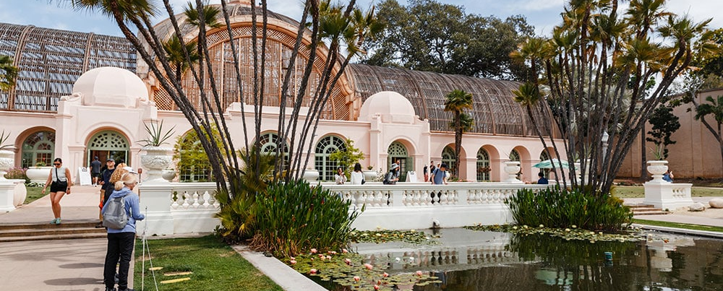
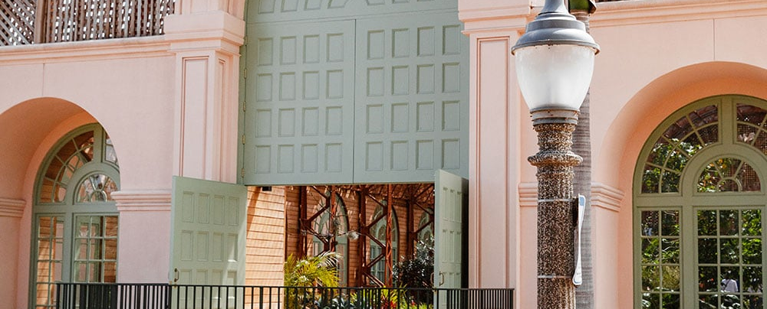
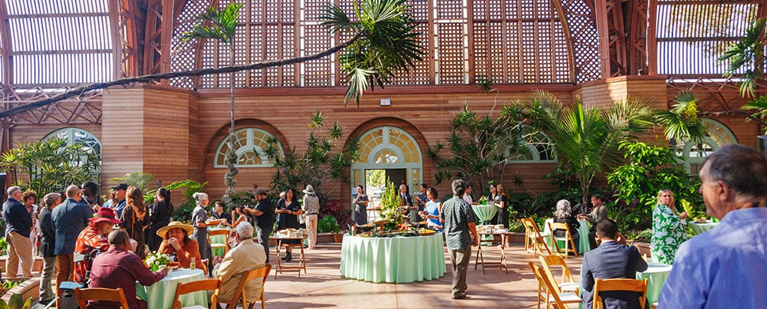
CALENDAR UX CONCEPT
A public calendar helps people plan a visit
Only approved public information appears here, with direct links back to each institution.
BALBOA PARK
What’s on Explore Plan your visit
A day of discovery
This weekend Free experiences Family Accessible
Garden encounters
Inside the Botanical Building
An evening in the park
Saturday / Free
View event and access details
Saturday / Family-friendly
Plan your visit
Sunday / Ticketed
Book with the organizer
Illustrative listings, not scheduled events. Photos: Forever Balboa Park. Existing public-calendar partners retain an editorial role.
55
Notes:
Original editable public-discovery concept. Sample event titles and dates are illustrative. Photography from Forever Balboa Park rental page is used to suggest a civic/cultural visual direction, not as proof these events exist. Filters should support date, free/ticketed, audience, accessibility, venue and transit. Public publishing requires owner approval, with cancellations propagated promptly. Existing balboapark.org public submissions and other calendars should be assessed for reuse and syndication. Ticket purchase stays with the event owner.
Sources checked 6 October 2026:
https://balboapark.org/contact-us/
https://foreverbalboapark.org/special-event-rentals/
Photo: https://foreverbalboapark.org/wp-content/uploads/2026/03/opt-fbp-botanicalbuilding-049.jpg
Photo: https://foreverbalboapark.org/wp-content/uploads/2026/03/opt-fbp-botanicalbuilding-035.jpg
Photo: https://foreverbalboapark.org/wp-content/uploads/2026/03/opt-fbp-sparkawards-2025-32.jpg

Slide 56
CALENDAR UX CONCEPT
A weekly edition makes Balboa Park a repeat destination
An AI agent assembles approved events. An editor checks the edition before it goes to subscribers.
BALBOA PARK
A shared visitor brand
What’s happening
in Balboa Park
One consistent weekly promise, with institutions credited and direct links to their bookings.
Your week of culture, gardens and discovery
Subscriber control
THIS WEEKEND
People opt in and choose interests. Institutions retain their own lists and customer relationships.
A night of science
Saturday evening at the Fleet / View event
Free experiences For families Plan your visit
Measure clicks, bookings and repeat engagement
Supported by [partner] / Clearly labelled sponsorship
Illustrative edition and events. Build on existing subscriptions and permissions. Free listings remain independent of sponsorship.
56
Notes:
Proposed extension of existing Balboa Park and FBP newsletters, not a claim that neither exists. Agent selects only owner-approved records, checks dates/status, removes duplicates, drafts concise descriptions and preference-based editions. A human editor checks factual accuracy, access information, representation of institutions and sponsor disclosures before sending. Cancellation updates must reach webpages promptly and newsletter corrections where needed. Subscribe through existing site, institution opt-in invitations, QR signage and event confirmations where consent permits. Do not automatically merge institution mailing lists or subscribe attendees. Track delivered email, unique clicks, unsubscribes, referrals and attributable net income rather than relying on open rates. Newsletter is a visitor relationship asset, not a forecast of large advertising income.
Sources checked 6 October 2026:
https://balboapark.org/
https://foreverbalboapark.org/wp-content/uploads/2026/03/FBP_AnnualReport25_online.pdf

Slide 57
CALENDAR UX CONCEPT
A shared enquiry can create leads for several institutions
The park helps organizers find a fit, then routes the opportunity to participating venues.
BALBOA / Host your event
Coordinated by Forever Balboa Park
Plan something memorable
FBP coordination team
Your brief | Illustrative enquiry
Event type | Company reception + museum experience
Guests / timing | 400–600 / October / dates flexible
Needs | Indoor reception, outdoor arrival, catering
Next step | Request matched venue options
Match capacity and availability
Confirm consent to share the brief
Route to the relevant institutions
Track proposals and bookings
Institutions set prices and accept bookings
Proposed service. Optional referral or coordination fees require contracts. Listing a self-hosted event remains free.
57
Notes:
Original editable lead-generation concept. Existing private-event and venue enquiry routes should be integrated. FBP can triage requests for multi-venue receptions, weddings, conferences and off-peak group visits. Event owners retain pricing, availability, contracting and customer relationships. Agree lead attribution, duplicate-lead rules, response times, referral permission and fees before launch. No automatic commission is assumed for ordinary events, free discovery listings, or existing institution clients. Track qualified enquiry, accepted referral, proposal, win, gross booking value and FBP retained fee separately. Research precedent: Fed Square reports five multi-venue bookings and16% more booked events following B2B strategy, not a transferable Balboa forecast.
Sources checked 6 October 2026:
https://balboapark.org/balboa-park-private-events/
https://foreverbalboapark.org/special-event-rentals/
https://cdn.artsprecinct.melbourne/assets/Melbourne-Arts-Precinct-Corporation-Annual-Report-2024-25.pdf

Slide 58
ILLUSTRATIVE ANNUAL MODEL / NOT CURRENT SUBSCRIBERS
Newsletter economics depend on an engaged audience
20,000
Example ticket referral income
5% of clicks become purchases
= 1,482 transactions
At $4 net commission each
= about $5,900 per year
average opted-in subscribers
52 editions × 95% delivery
× 3% click rate per delivered email
29,640 annual event-link clicks
The larger value is repeat visits, donor relationships and sponsor reach
All assumptions. Clicks and purchases can repeat across editions. Sponsorship in the business case bundles several park channels.
58
Notes:
Illustrative newsletter mechanics, no existing mailing-list analytics supplied. Average20,000subscribers x52editions x95%delivery x3%click-through per delivered email =29,640annualclicks. At5%purchase conversion =1,482transactions; at$4net contracted commission =$5,928. These would be a subset of the base-case4,000ticket/pass referrals, not additional revenue. Remaining2,518would need website or partner channels. Commission is only recognized with an agreed entitlement and tracked booking; normal free listings do not imply a charge. Unsubscribes, list growth and deliverability determine the average active list. Sponsor packages in the scenario combine web, newsletter and agreed event activations, not email display inventory alone. No current subscriber base, growth rate or conversion performance is asserted.
Sources checked 6 October 2026:

Slide 59
CALENDAR UX CONCEPT
An executive view supports timely intervention
The service highlights unresolved decisions and opportunities, with confidence made visible.
BALBOA / Park outlook
Coordinated by Forever Balboa Park
18
7,200–9,000
High
3
Events this weekend
Forecast visits across events
Parking pressure, Sat 16–19h
Open coordination issues
Needs attention | Owner | Next action
Museum plaza + City closure | City / FBP | Confirm alternate access route
School buses + event setup | Both institutions | Agree a 30-minute shift
Two adjacent evening events | Event owners | Explore shared shuttle and promotion
Data confidence
15 of 18 records updated
in the past 7 days.
Attendance is an estimate,
not a unique visitor count.
All figures are illustrative. Parking pressure combines event demand, normal visitation and available capacity assumptions.
59
Notes:
Original editable executive concept. Illustrative event total and attendance range are not project findings or a calculated live forecast. Visit totals across events can double count people. Production dashboard should distinguish expected event attendance, simultaneous occupancy, parking demand and observed actuals. Identify event overlaps, confidence, data freshness and accountable owners. Collaboration suggestions should be optional and not expose confidential commercial information.
Sources checked 6 October 2026:

Slide 60
ADOPTED CITY BUDGET / FY2026 TO FY2027
The funding target needs a precise definition
Published line | FY2026 budget | FY2027 adopted | Change
Citywide Organizational Support grants | $9.590m | $4.872m | −$4.718m / −49.2%
Balboa Park Division expenditure | $15.534m | $18.050m | +$2.516m / +16.2%
Institution grant losses and park operating needs are different
The City also confirms paid parking ends 1 January 2027. Its replacement funding challenge does not automatically become FBP’s funding obligation.
Sources: FY2027 Adopted Budget, Parks p. 388 and Special Promotional Programs p. 528. City parking update, 27 August 2026.
60
Notes:
City budget figures verified in adopted departmental PDFs, not earlier proposed reductions. OSP FY2026 budget9,589,606 vs FY2027adopted4,872,000, reduction4,717,606/49.195%. BalboaParkDivision expenditure15,533,771 vs18,050,079, rise2,516,308/16.199%. Expenditure is not net City subsidy and may reflect transfers or changed responsibilities. City parks report also describes custodial, ranger and security service reductions, so rising division spending does not establish improved service. Park-specific grant loss requires a recipient-level FY2026/FY2027 reconciliation. No verified single combined Balboa shortfall is established here. Needed bridge: affected institution grants, defined operating service deficits, other confirmed replacements, and separately the capital-maintenance backlog. City parking webpage confirms settlement ending paid parking1Jan2027. Do not add a forgone parking estimate to a grant reduction without reconciling funds.
Sources checked 6 October 2026:
https://www.sandiego.gov/sites/default/files/2026-08/fy27ab_v2parkandrec.pdf
https://www.sandiego.gov/sites/default/files/2026-08/fy27ab_v2specialpromo.pdf
https://www.sandiego.gov/parking/balboapark

Slide 61
FOREVER BALBOA PARK / REPORTED FINANCIAL BASELINE
FBP has an income base, but restricted funds limit flexibility
$7.41m
$4.79m
FY2025 total income
FY2025 total expenses
Most of the reported surplus supports restricted capital projects
FY2024 audited income included $817k rental income and $1.198m Visitors Center operations. These are existing revenues, before their costs.
FY2025 annual report, financial summary. FY2024 audited statements, statement of activities. Different periods shown explicitly.
61
Notes:
FBPFY2025 annual report PDFp9: total income7,412,906, expenses4,789,401. Report explains the majority of the surplus consists of donor-restricted advances for multi-year capital projects. Difference2,623,505 is not freely available recurring cash. FY2024 audited statement of activities printedp4/PDFp6 shows rental816,941 and visitor-center1,198,270. Both are income before associated expenses and must not be counted as incremental funding from this proposal. Rental includes existing House of Hospitality arrangements, not solely event bookings. Business case below includes only illustrative new activity after delivery costs; it does not raid restricted funds or assume existing income transfers to the new service.
Sources checked 6 October 2026:
https://foreverbalboapark.org/wp-content/uploads/2026/03/FBP_AnnualReport25_online.pdf
https://foreverbalboapark.org/wp-content/uploads/2025/01/Forever-Balboa-Park-FS.pdf

Slide 62
ILLUSTRATIVE STEADY-STATE SCENARIOS / US$ THOUSANDS
Annual net contribution ranges from a loss to $790k
Incremental annual activity | Cautious | Base | Stretch
Optional event-service fees | 90 | 360 | 960
Park-wide sponsorship packages | 50 | 200 | 450
Contracted ticket / pass referral income | 4 | 16 | 40
New unrestricted support | 30 | 100 | 250
Total new income | 174 | 676 | 1,700
Less direct delivery / fulfilment costs | (46) | (180) | (460)
Less central team, systems and overhead | (220) | (300) | (450)
Net recurring contribution | (92) | 196 | 790
Assumptions, not forecasts. No existing FBP income, institutional ticket gross, parking, restricted gifts or economic impact included.
62
Notes:
Calculated scenarios, annual steady state, USD. Event services:30/80/160bookings x gross fee3,000/4,500/6,000 =90k/360k/960k. Direct event delivery1,000/1,500/2,000 each =30k/120k/320k. Sponsorship2/4/6packages x25k/50k/75k =50k/200k/450k with20% fulfilment cost10k/40k/90k. Ticket/pass referrals1k/4k/10k transactions x$4 retained contracted commission=4k/16k/40k; already net of per-transaction leakage. New unrestricted support30k/100k/250k with20% incremental fundraising cost6k/20k/50k. Totalincome174k/676k/1.7m; direct46k/180k/460k; fixed220k/300k/450k; net−92k/196k/790k. No fixed-cost double counting in event costs. Sponsorship includes newsletter/web/events in one package, not overlapping separate sales. All counts, prices, margins and rights are unvalidated modeling inputs. Institutions retain venue/ticket revenue; model fees are separate opted-in services. Excludes one-time setup and timing/ramp effects.
Sources checked 6 October 2026:

Slide 63
ILLUSTRATIVE BASE-CASE OPERATING REQUIREMENTS
The base case needs a real sales pipeline and funded staff
80 paid service bookings / year
$300k annual central cost
400 qualified opportunities × 20% win rate
If 25% of enquiries qualify, the team needs 1,600 enquiries per year, about 133 per month.
Coordinator / operations: $120k
Sales and editorial capacity: $110k
Platforms and integrations: $30k
Overhead and contingency: $40k
$120k separate, one-time setup allowance
With base-case non-event contribution of $256k, about 15 service bookings cover the remaining $44k of central cost. Achieving the full $196k surplus needs all 80.
All assumptions. Setup: $40k service/design, $50k configuration/integration, $30k onboarding. Timing and procurement remain untested.
63
Notes:
Base case event contribution4,500fee minus1,500delivery=3,000perbooking. Non-event contribution160k sponsor +16k referral +80k support=256k. Fixedcost300k leaves44k, so ceiling44k/3k=15bookings for steady-state operating break-even only if all other assumptions deliver. To achieve196k net requires80bookings.400qualified x20%=80;1,600inquiries x25%=400. Existing-site visit estimate is not proof of enquiry volume, and traffic may be consumer rather than B2B. Assign inbound, partner referral, conference/hotel and outbound channels. Startup120k excluded from annual scenario. Even a full steady-state year at base net196k leaves76k after that one-time allowance; this is not a first-year forecast. Agree loaded compensation, procurement quotes, staffing time and channel rights.
Sources checked 6 October 2026:

Slide 64
ILLUSTRATIVE FUNDING-GAP SENSITIVITY / ANNUAL US$
Replacing millions requires more than the base case
Target net funding | Service bookings needed | Average per week
$1 million | 348 | 6.7
$2 million | 682 | 13.1
$5 million | 1,682 | 32.3
A larger funding strategy must include recurring partners and philanthropy
A calendar and audience channel can support that strategy. Safe capacity, institution benefit and the protected City service baseline still constrain growth.
Sensitivity only, not actual Balboa shortfalls or achievable event capacity. Holds base contribution of $3k per service booking.
64
Notes:
Required bookings = ceiling((targetnet +300,000fixedcost −256,000non-eventcontribution)/3,000eventcontribution). For1m,2m,5m:348,682,1682. Weekly figures divide by52. This deliberately exposes the scale challenge and is not a capacity forecast. Fixed costs would likely increase at such scale, so this understates the true requirement. Each booking must be incremental and eligible for paid optional services; listing self-hosted events remains free. Additional capital fundraising/endowment income and recurring sponsor or service agreements need their own case. Do not add modeled institution uplift to FBP surplus. Negotiate protection of agreed baseline City services and ring-fence new stewardship proceeds to avoid automatic offset by further reductions.
Sources checked 6 October 2026:

Slide 65
PROPOSED IMPLEMENTATION
A limited pilot can prove the operating model
Phase | Scope | Evidence to move forward
0–30 days: agreement | City, FBP and 6–8 volunteer institutions. Define spaces, authority and minimum fields. | Named owners, signed pilot compact, funded coordinator and confirmed permission boundaries
31–60 days: shared record | Enter the next 90 days, including City events and setup windows. Run two-weekly reviews. | Current records, working email intake and a baseline for subscriber and enquiry conversion
61–90 days: live coordination | Resolve real conflicts and test one shared event opportunity. Trial approved public publication. | Measured coordination benefits, tested paid-service demand and initial sponsor interest
After review: expand | Add institutions, integrations and optional event services. Plan toward a 2027 civic-event showcase. | Partners approve capacity, commercial agreements and a funded service budget
Timing is illustrative. This is a coordination pilot, not a promise to accelerate statutory approvals or deliver a large event in 90 days.
65
Notes:
Pilot should cover a meaningful shared-space interface such as the Fleet/Natural History Museum area, subject to consent, and include City-originated activity. The August project discussion names December Nights 2027 as a milestone. Use a selected zone or operational scenario as an initial test rather than promising to redesign the entire festival. Baseline current effort and incident patterns before launch. After 90 days, evaluate continuation and expansion against partner-agreed criteria.
Sources checked 6 October 2026:

Slide 66
DISCUSSION FOR BCCA, FBP, THE CITY AND INSTITUTIONS
The next decisions define the service and business case
01
Mandate
Does FBP host coordination and visitor marketing under a joint agreement?
02
Participation
Which City teams and institutions commit data owners and early notice?
03
Resources
Who funds the pilot, and what net annual funding target must the service meet?
04
Success
Which outcomes prove institutional benefit, qualified demand and net park income?
Recommended next step: agree a 90-day pilot brief and appoint one accountable lead per participating organization.
66
Notes:
Proposal for stakeholder discussion. No agreements or approvals implied. Success measures should include data coverage, days of advance notice, time to resolve issues, avoidable access incidents, incremental staff effort, institution net impact and satisfaction, public-access outcomes, and qualified collaboration opportunities. Agree definitions and baselines before selecting numeric targets.
Sources checked 6 October 2026:

Slide 67
APPENDIX
Evidence boundaries and remaining validation
Evidence category | What the deck uses | What it does not establish
Project interviews | Eight supplied PDFs and the referenced email discussion | Consensus, verified financial losses, current permits or official policy
Primary public research | Governance pages, annual accounts, rental processes, event listings and site rules | Complete internal calendars, unpublished workflows or actual participation outcomes
Strategic recommendations | Transferable patterns adapted to Balboa’s distributed authority | An adopted mandate, agreed fees, selected vendor or funded commitment
UX concepts | Editable illustrations of possible future workflows | Production software, real bookings, live feeds or verified forecasts
Priority checks: current agreements, City participation, institution impacts and Lincoln’s internal process
Research date: 6 October 2026. Historical reports retain their stated fiscal year.
67
Notes:
Interviews contain transcription errors, inconsistent names and different views. Avoid using unverified deferred-maintenance totals, hotel/Navy-land claims, parking-policy assertions or a universal 90/10 split. The wider workshop output and financing white paper are mentioned in interviews but were not supplied, so their completion or findings are not assumed. Research focuses on relevant governance, event operation and platform evidence. Photos are source-attributed, with individual photographer credit when found.
Sources checked 6 October 2026:

Slide 68
SOURCE REGISTER
Project evidence behind the opening findings
Source in uploaded files | Relevant material
Howard Blackson interview, 7 July 2026 | pp. 2–3: fragmentation, event access and public-space concerns
Chris Sichel interview, 2 July 2026 | pp. 2–4: shared revenue, FBP role and unified destination marketing
Michael Stepner interview, 22 June 2026 | p. 3: equitable sharing, public use and neighboring institutions
Fleet / Steve interview, 17 August 2026 | pp. 2–3: event impacts, shared spaces and revenue-neutral principle
Casey Smith interview | pp. 1–2, 7–9: stewardship, outdoor events and maintenance contributions
Project meetings, 15 July, 29 July, 13 August | Governance tension, shared-event alignment and shared business vision
Sophia email, 29 September 2026 | Internal calendar request, biweekly Balboa meetings and Lincoln visit account
Interview claims remain attributed to the speakers. Page numbers refer to supplied PDFs.
68
Notes:
Files: Howard Blackson - Interview.pdf; Interview Chris Sichel(1).pdf; Michael Stepner - Interview.pdf; 1e91de1b-6b86-47bc-88e9-e01a4a0ece26_Meeting_Last_Monday_1100_PM.pdf; Interview Guest Casey Smith.pdf; 62e9d4ce-2e39-4e35-9099-916304ca078c_July_15_2026_532_PM(1).pdf; d3298bc4-0640-4d87-aaf5-eb241bc362e4_Last_Wednesday_547_PM(1).pdf; 12383d65dfa-44b9-4471-a3cd-12f64a2bb6c4_August_13_2026_441_PM.pdf. Prior conversation: Strategic Operating Model Deck, conversation ID 6ac4b909-91ec-83eb-975f-8237dbfa890e.
Sources checked 6 October 2026:

Slide 69
SOURCE REGISTER
Primary sources: campus and district models
Lincoln Center
About and resident organizations
2025 audited accounts, note 2(l)
Summer for the City calendar
MuseumsQuartier
Ownership and operator mandate
Event rentals and service team
Federal operating support
South Bank
BID governance and funding
2024–2029 business plan
Public destination calendar
Links are clickable. Detailed claim and photo sources appear in the notes of the relevant slides. Checked 6 October 2026.
69
Notes:
Further primary sources include MQ Summer Stage and site event rules, South Bank strategic partnership working and Lincoln Center Campus Fund.
Sources checked 6 October 2026:
https://www.lincolncenter.org/i/about
https://res.cloudinary.com/lcpa-fountain/image/upload/niwonxm9iflxomsrlslo
https://www.lincolncenter.org/series/summer-for-the-city/v/calendar
https://www.lincolncenter.org/support/
https://www.mqw.at/en/the-mq/organization/
https://www.mqw.at/en/rentals/
https://www.mqw.at/en/program/mq-summer-stage/
https://transparenzportal.gv.at/tdb/tp/leistung/1065671.html
https://service.mqw.at/wp-content/uploads/2024/10/MQ-Haus-und-Veranstaltungsordnung-Areal.pdf
https://southbankbid.co.uk/about-us
https://southbankbid.co.uk/assets/publications/south-bank-bid-third-term-business-plan-%281%29.pdf
https://southbank.london/whats-on
https://southbankbid.co.uk/services/business-support/strategic-partnership-working

Slide 70
SOURCE REGISTER
Primary sources: operations and local foundations
Fed Square
Event planning and partner venues
Contractor induction and Linksafe
Annual reporting and governance
Forest Park
2024 City–conservancy agreement
Distributed rentals and permit routing
Public calendar
Balboa and platforms
Forever Balboa Park rentals
Existing Balboa Park event submission
Microsoft Lists calendar view
Historical Fed Square revenue categories: FY2022–23 report. Latest report reviewed: FY2024–25. Platform sources are vendor documentation.
70
Notes:
Source and image attribution. Photographers identified where public source provides credit: MuseumsQuartier Summer Stage, Thomas Meyer; Fed Square Candlelight Concert, Damien Raggatt; South Bank London riverside terrace image, Naomi (credit as supplied by website asset). Lincoln Center, Forever Balboa Park and Forest Park Forever photos from their official websites, individual photographer not established. Exact asset URLs in slide notes. No claim that photo permissions transfer with this deck.
Sources checked 6 October 2026:
https://fedsquare.com/about
https://fedsquare.com/plan-your-event
https://fedsquare.com/site-induction
https://www.parliament.vic.gov.au/globalassets/tabled-paper-documents/tabled-paper-7669/melbourne_arts_precinct_corporation_annual_report_2022-23.pdf
https://cdn.artsprecinct.melbourne/assets/Melbourne-Arts-Precinct-Corporation-Annual-Report-2024-25.pdf
https://fedsquare.com/media-centre
https://www.forestparkforever.org/news/2024/forest-park-forever-city-of-st-louis-renew-public-private-partnership-to-sustain-forest-park-for-decades
https://www.forestparkforever.org/rentals
https://www.forestparkforever.org/calendar
https://foreverbalboapark.org/special-event-rentals/
https://balboapark.org/contact-us/
https://balboapark.org/balboa-park-private-events/
https://support.microsoft.com/en-us/sharepoint/lists/create-a-calendar-view-from-a-list
https://elitesupportcenter.ungerboeck.com/hc/en-us/articles/17437538251415-Conflict-Checking
https://gomomentus.com/momentus-answers

Slide 71
BUSINESS-CASE APPENDIX / ANNUAL STEADY STATE
Scenario assumptions are transparent and replaceable
Input | Cautious | Base | Stretch
Paid service bookings | 30 | 80 | 160
Fee per booking / direct cost | $3,000 / $1,000 | $4,500 / $1,500 | $6,000 / $2,000
Sponsor packages × annual price | 2 × $25k | 4 × $50k | 6 × $75k
Sponsor fulfilment cost | 20% | 20% | 20%
Ticket / pass transactions × net income | 1,000 × $4 | 4,000 × $4 | 10,000 × $4
New unrestricted support / acquisition cost | $30k / 20% | $100k / 20% | $250k / 20%
Central annual cost | $220k | $300k | $450k
Every input is an assumption. Revenue entitlement, demand, fulfilment costs and incremental attribution need validation.
71
Notes:
Interpretation: paid services are opt-in packages such as multi-venue coordination and production support, separate from venue rental and free listings. Sponsorship is a bundled park-wide partnership, not newsletter ads alone. Ticket/pass referral income needs signed agreements; free ordinary listings carry no commission. New unrestricted support is attributable new giving, not restricted capital contributions or existing donors merely shifted channels. Cost20% is an assumption, not an established nonprofit fundraising benchmark. Evaluate institution foregone margin, access costs and public-benefit outcomes separately; none are assumed zero or counted as FBP income.
Sources checked 6 October 2026:

Slide 72
ADDITIONAL SOURCE REGISTER
Sources for demand, channels and commercial evidence
Search demand
Semrush U.S. keyword volumes and site traffic
Google Keyword Planner methodology and settings
Existing channels
Balboa Park events, tickets and newsletter
Advertising and sponsorship enquiries
Commercial benchmarks
MAP Co FY2024–25, pp. 158–159 and 196–197
Google event discovery documentation
Checked 6 October 2026. Semrush provides third-party estimates. Business-case inputs are assumptions, not sourced market prices.
72
Notes:
Source periods are visible on individual slides. Google structured data gives eligibility, not guaranteed search placement. No Search Console, Google Analytics, mailing-list or CRM account was available for first-party conversion validation.
Sources checked 6 October 2026:
https://www.semrush.com/website/balboapark.org/overview/
https://support.google.com/google-ads/answer/6325025?hl=en-EN
https://balboapark.org/
https://balboapark.org/advertising-sponsorships/
https://cdn.artsprecinct.melbourne/assets/Melbourne-Arts-Precinct-Corporation-Annual-Report-2024-25.pdf
https://developers.google.com/search/docs/appearance/structured-data/event

Slide 73
ADDITIONAL SOURCE REGISTER
Sources for the funding baseline
City of San Diego
FY2027 Parks and Recreation budget, p. 388
FY2027 Special Promotional Programs, p. 528
Forever Balboa Park
FY2025 annual report financial summary
FY2024 audited statement of activities
Further context
City update on the end of paid parking
Forest Park Imagine the Glade campaign
A recipient-level Balboa grant reconciliation and an agreed operating-services baseline remain necessary to set a replacement target.
73
Notes:
Use adopted budget figures rather than proposed cuts. Funding sources have different legal restrictions, beneficiaries and periods. Capital maintenance backlog is a stock and must not be added to a recurring annual gap. All operating-scenario income is incremental and excludes existing FBP revenues.
Sources checked 6 October 2026:
https://www.sandiego.gov/sites/default/files/2026-08/fy27ab_v2parkandrec.pdf
https://www.sandiego.gov/sites/default/files/2026-08/fy27ab_v2specialpromo.pdf
https://foreverbalboapark.org/wp-content/uploads/2026/03/FBP_AnnualReport25_online.pdf
https://foreverbalboapark.org/wp-content/uploads/2025/01/Forever-Balboa-Park-FS.pdf
https://www.sandiego.gov/parking/balboapark
https://www.forestparkforever.org/news/steinberg-at-the-glade
https://www.mqw.at/en/mq-press-page/general-information/
https://transparenzportal.gv.at/tdb/tp/leistung/1065671.html

Slide 74
CLOSING COMPARISON
Benchmark recap: geography, scale and visitation
Place / city / country | Size and boundary | Annual visitation evidence
Balboa Park · San Diego · USA | 1,200 acres / about 486 ha Entire park | Comparable recent annual park total not verified in this review
Lincoln Park · Chicago · USA | About 1,200 acres / 486 ha Published boundaries differ slightly | 20m+ annual visitors, Conservancy claim Undated estimate; method not published
Forest Park · St. Louis · USA | 1,300 acres / about 526 ha Operator’s stated park area | 15.5m annual visits 2024 City–conservancy announcement
Lincoln Center · New York · USA | 16 acres / about 6.5 ha Arts campus | Current campus annual total not verified 1.6m festival visits since 2022 is cumulative
MuseumsQuartier · Vienna · Austria | 59,095 m² / 5.91 ha land area 2025 report, not gross floor area | 5m site visits 2025 operator report
Fed Square · Melbourne · Australia | 5,000 m² / 0.5 ha Main Square only Full precinct area not verified here | 10m+ visitors per year 2024–25 operator report
South Bank · London · UK | BID district boundary Comparable land area not established | 38m+ footfall in 2025 BID analysis of HSDS data
Visits / footfall are not unique people. Boundaries and counting methods differ. No revenue-per-visitor league table.
74
Notes:
Benchmark update checked 7 October 2026. Lincoln Park Conservancy lists 1214 acres and 20m+ annual visitors without measurement year or method. Park District description lists 1188.62 acres with a conflicting historical figure. Use rounded 1200 acres, about486ha, avoiding false precision. Size conversions calculated using1acre=0.40468564224ha. Forest current About page and2024renewal describe1300acres; other publications use differentareafigures, so retainoperatorboundary. MQ2025reportprintedpp6–9:59095m² propertyland,114310m²grossfloorarea,26573m²unbuilt and32522m²built. Do not substitute grossfloorarea forland. 5m visitorsreport2025. Lincoln2026festivalpressrelease gives16acres and1.6m cumulativefestivalvisitorssince2022, notannualcampuscount. Fedreportprintedpp28–29gives10m+peryear. 5000m² is MainSquare only. SouthBank2026March9reportgives38m+footfall2025,notSouthbankCentre attendance.
Sources checked 6 October 2026:
https://www.chicagoparkdistrict.com/parks-facilities/lincoln-abraham-park
https://www.lincolnparkconservancy.org/about-us/about-lincoln-park/
https://www.sandiego.gov/planning/work/balboa-park-master-plan-update
https://www.forestparkforever.org/about
https://www.forestparkforever.org/news/2024/forest-park-forever-city-of-st-louis-renew-public-private-partnership-to-sustain-forest-park-for-decades
https://pressroom.lincolncenter.org/press-releases/view/69dfd30b658f89d111bbb80a
https://www.mqw.at/documents/42/MQ_Jahresbericht-2025-versand.pdf
https://cdn.artsprecinct.melbourne/assets/Melbourne-Arts-Precinct-Corporation-Annual-Report-2024-25.pdf
https://fedsquare.com/venues/main-square
https://southbankbid.co.uk/news/key-takeaways-from-our-latest-data-research-insights-event

Slide 75
CLOSING FINANCIAL COMPARISON
Benchmark recap: income and financial result
Reporting entity / period | Reported income | Result and interpretation
Lincoln Park Zoological Society only FY2025, US dollars | US$43.69m support before investment income US$13.20m investment income separately | US$11.47m increase in net assets US$1.72m deficit before investment income
Lincoln Center for the Performing Arts FY2025, US dollars | US$245.11m total revenue Includes giving and investment returns | US$15.23m consolidated surplus General operating column: US$0.34m deficit before transfers
Forest Park Forever 2024, US dollars | US$53.53m public support and revenue Includes US$19.60m investment return | US$32.39m increase in net assets US$31.40m of that increase has donor restrictions
MAP Co, including Fed Square FY2024–25, Australian dollars | A$62.77m revenue and income A$29.44m operating income within total | A$15.00m net deficit Includes wider precinct project costs and depreciation
Operator accounts only, not all institutions combined. Nonprofit results are not distributable profit. Currencies and scopes differ.
75
Notes:
Benchmark update checked 7 October 2026. Chicago figures are zoo-only, not Conservancy or total park accounts. Zoo FY2025 audited statement p4, note1 p8 and note2 p9. LCPA2025 consolidatedstatementprintedp4:revenue245111,expense229886,surplus15225(allUS$000). Generaloperatingrevenues172505less172846=-341beforetransfers. FPF2024statementofactivitiesprintedp4:53527606support/revenue,21142072expenses,32385534netassetincrease;restricted31399526,unrestricted986008. This is as stated inactivities; does not represent eventprofit or freecash. MAPCo2025comprehensiveoperatingstatementprintedp190:revenue/income62768494;operatingincome29436815;netresult-15001921. NotFedSquarestandaloneprofit. Avoid subtracting selectedeventcostsfromeventrevenue as netprofitbecause overhead and scope differ.
Sources checked 6 October 2026:
https://www.lpzoo.org/wp-content/uploads/2025/11/101286-Lincoln-Park-Zoo-0325-AUD-FS-Final.pdf
https://res.cloudinary.com/lcpa-fountain/image/upload/niwonxm9iflxomsrlslo
https://www.forestparkforever.org/s/2024_Forest_Park_Forever_FINAL_FS.pdf
https://cdn.artsprecinct.melbourne/assets/Melbourne-Arts-Precinct-Corporation-Annual-Report-2024-25.pdf

Slide 76
CLOSING FINANCIAL COMPARISON
Benchmark recap: the commercial income engines
Operator | Business income evidence | What this means for Balboa
Lincoln Park Zoo / FY2025 | US$15.21m visitor services, including events, parking and concessions. US$5.86m District subsidy. | Income rights are explicit in the zoo agreement. These are zoo figures, not Conservancy income.
Lincoln Center / FY2025 | US$50.77m halls and related income in general operations; US$35.41m facility services | Charge transparently for real spaces and shared services. These figures precede costs.
Fed Square / FY2024–25 | A$4.32m events; A$0.54m sponsorship; A$19.57m tenancy rents; A$5.01m parking | A diversified precinct business supports events. Balboa cannot assume rights to these income sources.
Forest Park Forever / 2024 | US$0.34m other income. Commercial-only split not disclosed in reviewed accounts | Philanthropy and investment income dominate. Conservancy success need not mean an event-profit engine.
MuseumsQuartier / 2025 review | Rentals and event services verified. Comparable revenue and profit figures not established | A service model is visible. Financial performance remains an evidence gap.
South Bank BID / 2026–27 plan | £1.58m planned total income, including about £1.50m levy funding | Member funding supports collective services. This is a plan, not actual commercial sales or profit.
Figures are not additive across operators or currencies. ND is an evidence gap, never zero. Tenant museum ticket sales are separate.
76
Notes:
Benchmark update checked 7 October 2026. LCPA hallsfigureexcludesUS$14.1mredevelopmentdeferredrevenuerecognitionincludedinconsolidatedhallstotalUS$64.872m. Fedfinancialsnote2.1givesevents4316172,sponsorship539878,tenancy19565002,carpark5011464AUD. FPFother335985cannotbeclassifiedwhollycommercial. MQ2025publicannualreportreviewedforfinancialterms; usablecomparablerevenue/profitnotestablished. Federalportaloperatinggrantnotusedasrevenueproxy. SouthBank2026–27plan1576792total,1440000levy+55125newdevelopments. NooperatingsurplusverifiedforSouthBankorMQ.
Sources checked 6 October 2026:
https://www.lpzoo.org/wp-content/uploads/2025/11/101286-Lincoln-Park-Zoo-0325-AUD-FS-Final.pdf
https://res.cloudinary.com/lcpa-fountain/image/upload/niwonxm9iflxomsrlslo
https://cdn.artsprecinct.melbourne/assets/Melbourne-Arts-Precinct-Corporation-Annual-Report-2024-25.pdf
https://www.forestparkforever.org/s/2024_Forest_Park_Forever_FINAL_FS.pdf
https://www.mqw.at/documents/42/MQ_Jahresbericht-2025-versand.pdf
https://www.mqw.at/en/rentals/
https://southbankbid.co.uk/assets/publications/south-bank-bid-third-term-business-plan-%281%29.pdf

Slide 77
ANALYTICAL SCORECARD
Recap: relevance to Balboa Park on a 1–5 scale
Benchmark | Stakeholder fit | Park / space fit | Coordination lesson | Commercial lesson
Lincoln Park · Chicago, USA | 5 / 5 | 5 / 5 | 4 / 5 | 4 / 5
Forest Park · USA | 5 / 5 | 5 / 5 | 4 / 5 | 2 / 5
Lincoln Center · USA | 3 / 5 | 2 / 5 | 5 / 5 | 4 / 5
MuseumsQuartier · Austria | 3 / 5 | 2 / 5 | 4 / 5 | 3 / 5
Fed Square · Australia | 3 / 5 | 2 / 5 | 5 / 5 | 5 / 5
South Bank · UK | 3 / 5 | 2 / 5 | 4 / 5 | 3 / 5
Closest park comparisons: Lincoln Park and Forest Park.
1 = limited relevance 3 = partial relevance 5 = strong relevance Scores are our judgment, not performance ratings.
Size, city, visits and financial results remain factual fields on the preceding slides. A high score does not mean higher profit.
77
Notes:
Benchmark update checked 7 October 2026. Lincoln Park scores 5 stakeholder fit, 5 park fit, 4 coordination and 4 commercial lesson. The park district differs from San Diego City governance. Commercial lesson derives from zoo agreement, not Conservancy revenue. No verified park-wide internal calendar. Unweightedsubjectiverelevanceassessmentbasedonreviewedevidence. Stakeholderfitcriteria:municipalpublicspace,separatesteward/conservancy,independentinstitutions. Parkfit:largeopenmunicipalparkwithcultureandrecreation. Coordinationlesson:transferablegovernance/sharedservices/eventdelivery,notsoftwarematurity. Commerciallesson:documentedrelevantvenue/serviceincomeanddiversification,notprofitranking. Intermediate2/4indicatebetweenscaleanchors. Forest5/5becauseCity+nonprofit+institutionsatcomparablescale;commercial2becausemainfundingisgiving/investments. Lincolncoord5forcommonservices,notverifiedweeklysoftware. Fedcommercial5forreportedbusinesscategoriesandmulti-venuebookings. Noglobaloverallrankbecausecriteriahavedifferentpurposes.
Sources checked 6 October 2026:
https://www.lincolnparkconservancy.org/about-us/
https://www.chicagoparkdistrict.com/parks-facilities/lincoln-abraham-park
https://www.lpzoo.org/wp-content/uploads/2025/11/101286-Lincoln-Park-Zoo-0325-AUD-FS-Final.pdf
https://www.forestparkforever.org/news/2024/forest-park-forever-city-of-st-louis-renew-public-private-partnership-to-sustain-forest-park-for-decades
https://www.forestparkforever.org/rentals
https://res.cloudinary.com/lcpa-fountain/image/upload/niwonxm9iflxomsrlslo
https://www.mqw.at/documents/42/MQ_Jahresbericht-2025-versand.pdf
https://cdn.artsprecinct.melbourne/assets/Melbourne-Arts-Precinct-Corporation-Annual-Report-2024-25.pdf
https://southbankbid.co.uk/assets/publications/south-bank-bid-third-term-business-plan-%281%29.pdf

